Slide 1
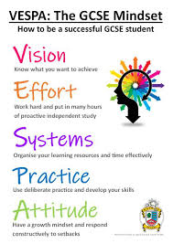

St Julian’s Sixth Form
VESPA Programme - The A Level Mindset
How to be a successful A Level student

Slide 2
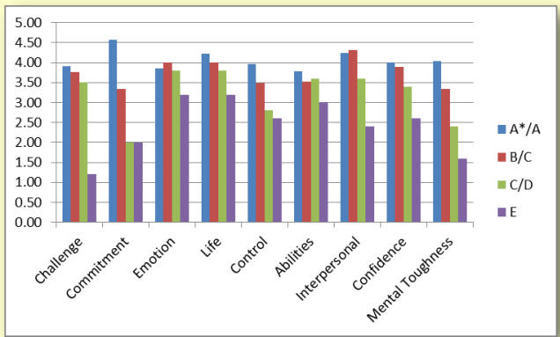
VESPA - The GCSE / A’ Level Mindset
Commitment correlates most strongly with attainment. A*/A grade students demonstrate high levels of commitment compared to all other grade groups. (Source MTQ48: 2013).

Slide 3
What is VESPA ?
• Developed by Steve Oakes and Martin Griffin at a 6th Form College in Oldham
• Identified 5 areas that if underdeveloped, led to underperformance in A levels
• The VESPA mindset is a series of diagnostic activities to help identify in which area you must develop as a student

Slide 4
What is VESPA ?
“Since we realised this, and we started teaching students these five skills, we’ve seen more and more students get better and better grades. Our students outperform most other students in the country.
Students get into better universities and get better jobs and we’ve been rated as one of the best school sixth forms in the country. Our students aren’t any more
intelligent than the students that came before them.
Instead, they have begun to learn a series of behaviours and thought processes.”
Steve Oakes 2018

Slide 5
What does VESPA stand for ?
Vision:
How well do you know what you want to achieve?
Effort:
How many hours of independent work do you do?
Systems:
How do you organise your learning and organise your time?
Practice:
What kind of work do you do to practice your skills?
Attitude:
How do you respond to setbacks?

Slide 6

Vision

Slide 7
LOW VISION STUDENTS
• Listless
• Bored
• Low level anxiety
• Exasperated
• Tendency to procrastinate

Slide 8
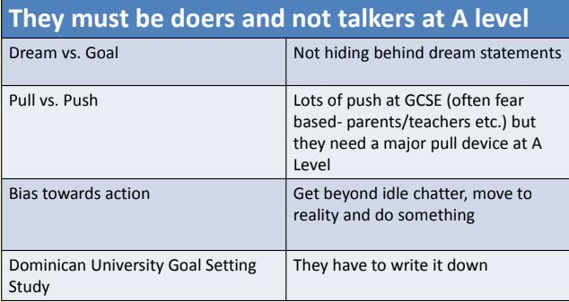
VISION – KEY PRINCIPLES

Slide 9
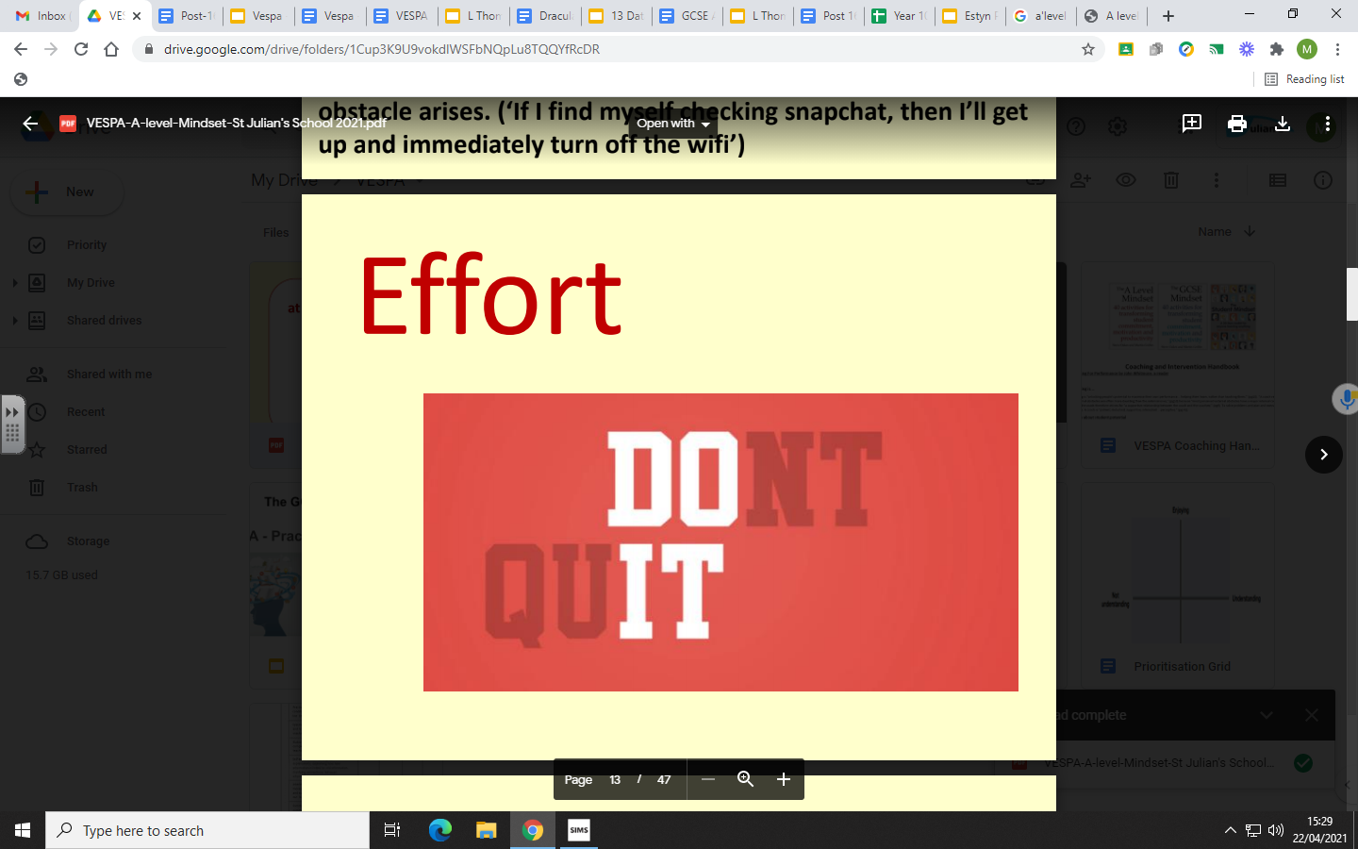
Effort

Slide 10
‘LOW EFFORT’ STUDENTS
• Make friends with other low effort students
• Effort is relative – “Seriously, no one does that!”.
• They don't know anyone who works as hard we say they have to work
• They will adjust peer groups to avoid work
• They think going to lessons & doing their homework is ENOUGH
• They need help in breaking down their view of what is ‘normal’

Slide 11
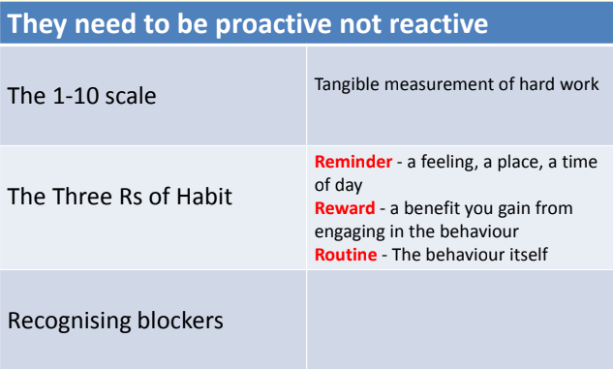
EFFORT Key Principles

Slide 12

Systems

Slide 13
Low Systems Students
Poor sleep
• Chaotic bags/ folders/notes
• “I didn't do your homework because I was doing sociology”
• The way they work has always worked up to now
• They miss deadlines because they didn’t even know there was a deadline
• They are experiencing v high stress- they are experiencing the car crash

Slide 14
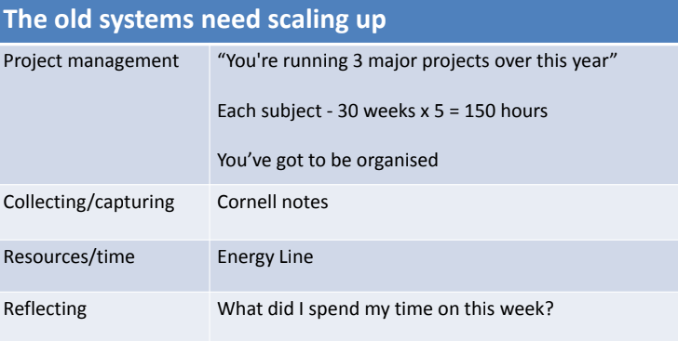
Systems - Key Principles

Slide 15

Practice

Slide 16
Low Practice Students
• Large expense on stationery
• Flash cards/mind maps/copying out notes etc
• High effort / high practice systems- but underperforming - loyal to GCSE practices
• Many kids have a poverty of practice even though they are working hard
• Some confusion from us: how do we really answer: how do I study?
• Different answers from different departments
• Breadth of preparation of activities essential

Slide 17
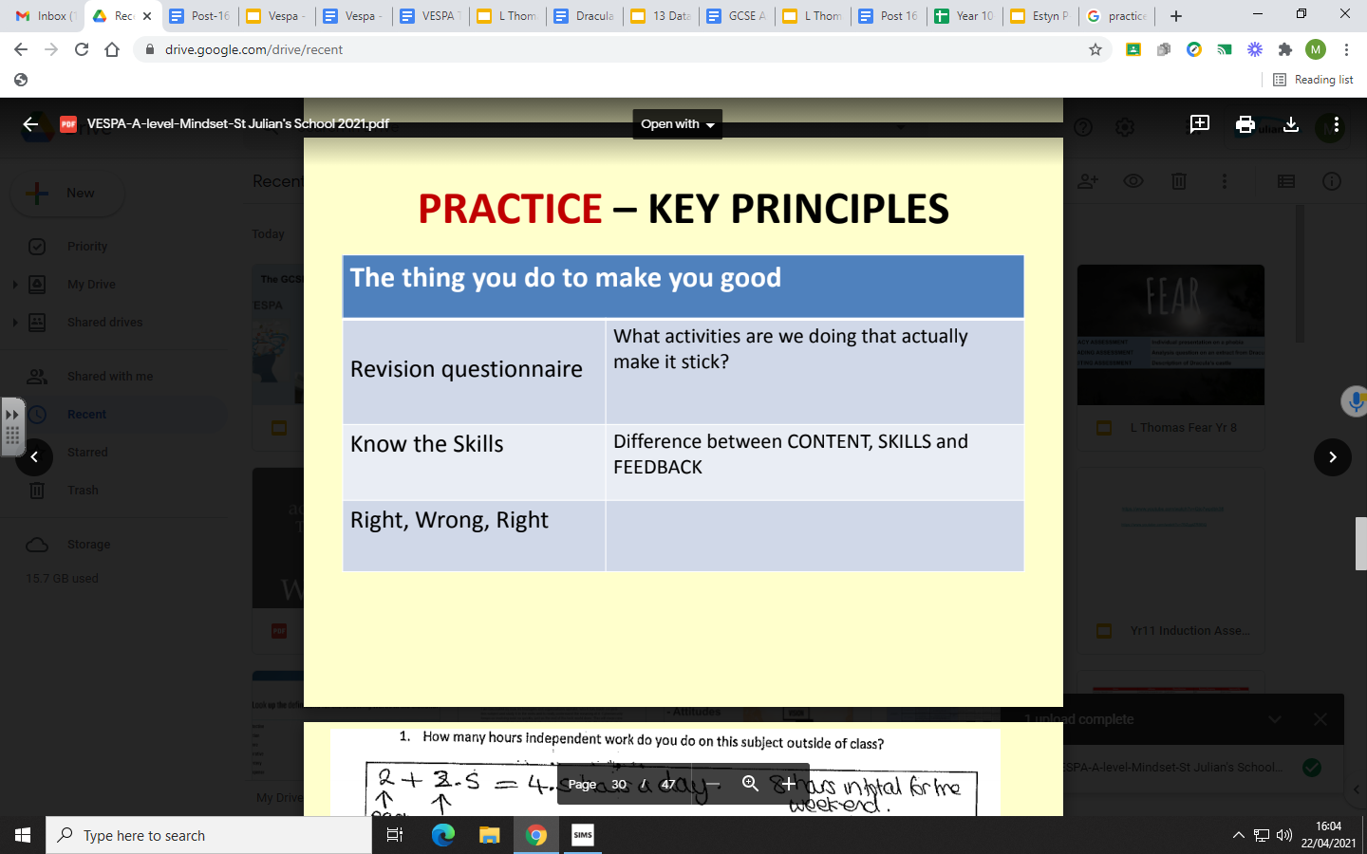
Practice - Key Principles

Slide 18
MOST STUDENTS SPEND ALL OF THEIR STUDY TIME ON CONTENT
• If you spend hours making flash cards, mind maps, writing out notes, endlessly re-reading text books, looking for new ways (e.g. looking
for clips on you tube) on a topic you already KNOW
• You are wasting valuable time, you are focussing on the WRONG THING

Slide 19
What does work ? You need to think hard
• Quizzing and self testing (retrieval practice) – create flash cards, quiz yourself, quiz others, BBC bitesize quiz, quiz apps, create mind maps – Put your notes away and force yourself to remember
• Spreading out your revision – imagine watering the garden – instead of a 3 hour block – revise for 1 hour over 3 days.
• Teaching others – why? So what?
• Elaboration– why? How does this link to what I have already learnt? What are the big ideas? Summarise what you have learn in the form of a diagram
• Get rid of distractions
• Metacognition and self regulation (help pupils think about their own learning more explicitly, often by teaching them specific strategies for planning, monitoring and evaluating their learning)

Slide 20
Above and beyond......
Re-drafting and re-doing work to a better standard
Researching and recording
Extended reading – Newspapers, blogs, journals,
magazines, publications, TED talks, technical language
Subject associations – hold local lectures and talks
Debating topical issues
Virtual classrooms (webinars, online lectures etc)
Visiting museums, libraries, etc
Work experience

Slide 21

Attitude

Slide 22
Low Attitude Students
• Errors are leverage points for further learning - self belief
• We don't/can't be a cheerleader for the kids
• A failure is a terrible waste if we don't use it
• “I'll have a word”- what word? how is it recorded?
• Move from the language of "the word"

Slide 23
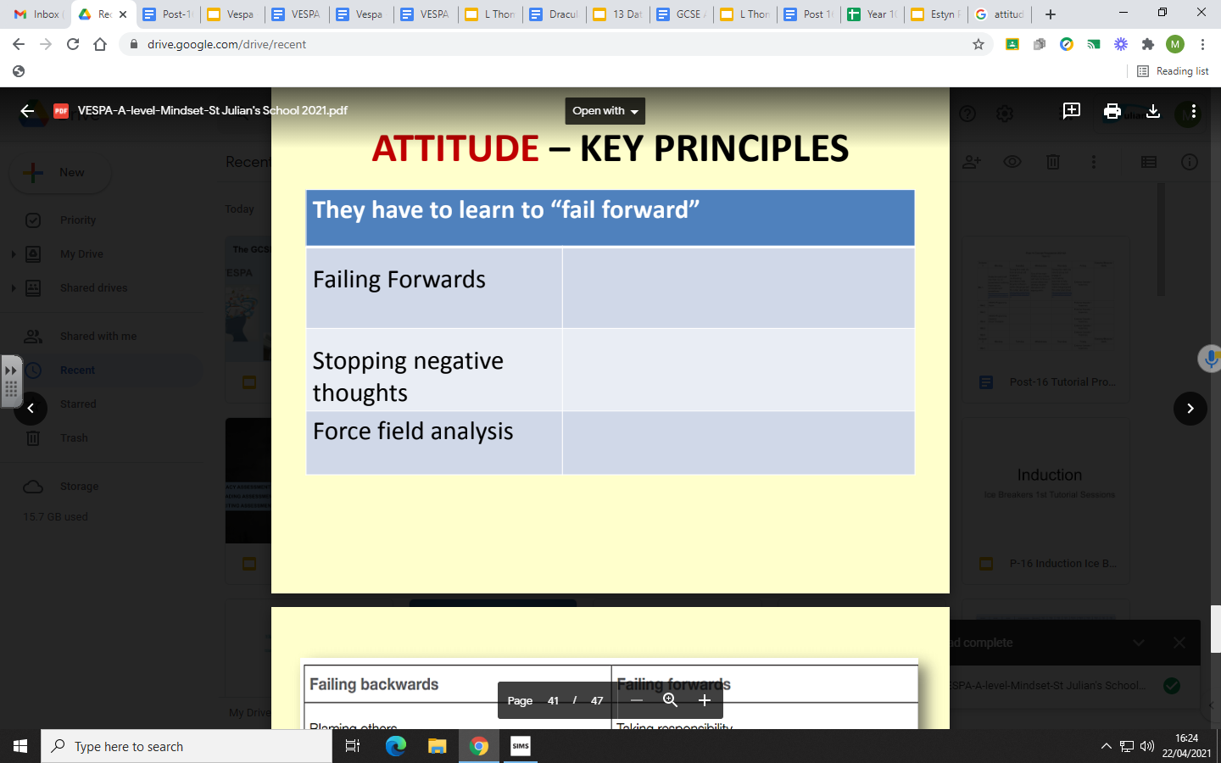
Attitude - Key Principles

Slide 24
SOME COMMON BARRIERS TO DEVELOPING A POSITIVE ATTITUDE TOWARDS LEARNING
When study is secondary to...
• Paid employment
• Social media and social life
• External commitments
• Time off does not allow for study habits to be embedded
When A Levels are not understood to be of value in their own right...
• Unconditional university offers
• Short term ‘gain’ gives way to long term detriment

