Slide 1

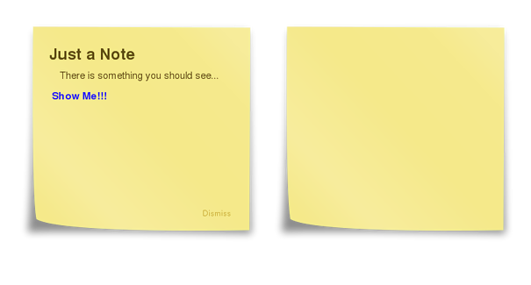
From
Post 16 students
Revision Guidance

Slide 2

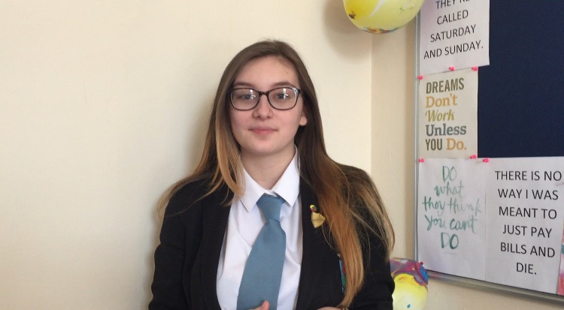

Click to watch the
Post 16 playlist of advice

Slide 3
At Home
Don't listen to music with words, you might end up singing the songs and not focusing. That would be a big distraction
Set yourself a revision plan (I used getrevising.com) Its very good so you know what to revise and when.
Never prioritise a certain subject, only exception being if you struggle more in the a certain subject.
In RS I struggled with my timing, so i answered the bigger mark questions first, then worked my way to the larger marks.
In School
Focus in lessons, that time is very important and always see your teacher if you struggle. Don't be afraid to ask qquestions.
Turn up to revision lessons, they are put in place to help you even more.
If you struggle to remember things (like I did), make flash cards, they were my own favourite way I revised from.
Anna Sutcliffe

Slide 4
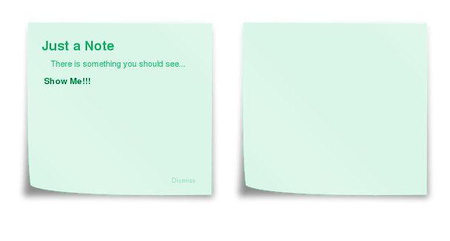
Revise each exam so that you have a good chance with each one. Don't use all of your time just revising, have some time to yourself. Don't revise late at night and revise in a quiet room unless music helps.
Take any extra lessons if you can attend and always attend lessons. If there are any past papers available make sure you do as many as you can.
Kyle Mozoo

Slide 5
Start work when it gets set
Revise early so you can do it in smaller amounts
Do pastpapers
Jack Knowles

Slide 6
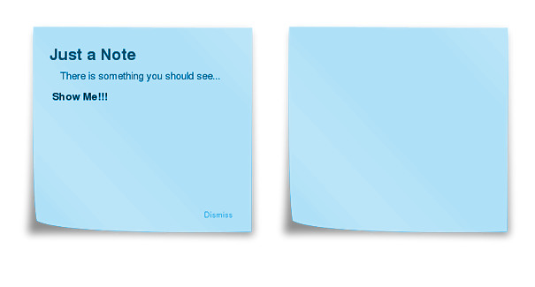
Revise as soon as possible, don't over revise and have some free time equally as much, don't listen to music while revising, and for year 12-13 make sure you choose something you're interested in as it'll be much easier to understand.
Rebekah Baugh

Slide 7
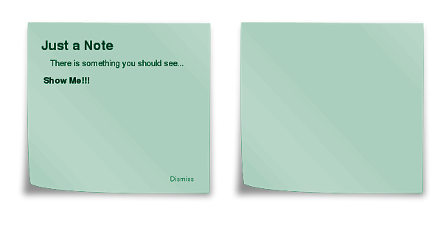
With revision, creating mind maps for a topic of your chosen subject before the exams of the information you know is a good way to remember what you know. Look over information that has been left out and add to it.
Lucy Chappell

Slide 8
While revising is good and all, try not to bite off more then you can chew.
Start small otherwise you may feel overwhelmed and might keep putting it off and end up never doing it.
Caleb Murphy

Slide 9
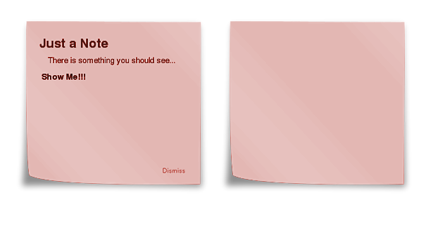
Take breaks there is no need to learn everything in one sitting, take your time and revise when you feel it would be the best time to do so.
Thomas Jones

Slide 10
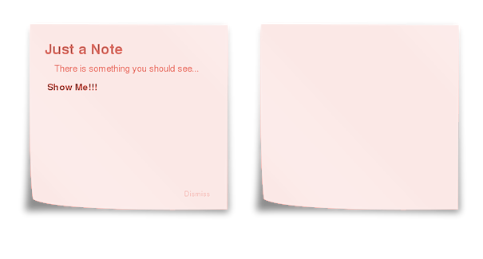
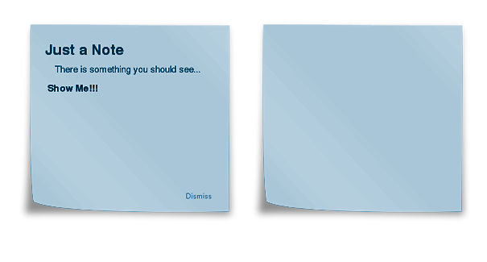
Memory games
Create acronyms
Songs & singing
Flash cards
Post-it notes
Keywords
YouTube & Podcasts
Past paper questions
Teaching someone else
Record your notes on phone
Mind mapping
See one, do one, teach one

