Slide 1


Key Stage 4
Revision Guidance

Slide 2
CONTENTS
Parents
  Finding the right environment
  Planning
  Support
  Top Tips
  The exam period
  Exam technique
  Helpful apps/websites
Students
  5 steps to success
  Self assessment
  STEP 1: Prepare to revise
  STEP 2: Plan a revision timetable
  STEP 3: Develop the right mentality
  STEP 4: Use all of your time effectively
  STEP 5: Be successful

Slide 3
PARENTS

Slide 4
Parents
Parents have a major role to play in ensuring the preparation stage for examinations runs as smoothly as possible. Encouraging your child to see the importance of the exams is the first approach you should take- if you do not see the value of success yourself, there is little chance that your child will. Unfortunately, the present economic climate means that competition for employment, further education and university places is very different from when you were at the same stage in your life.
It helps to offer reassurance that the process will soon be over and that investment of time and effort now will have a major impact on the quality of life in the future. Social media, games consoles and their mobile phones will still be there for them in the summer!
The best way to support your child during the stress of revision and exams is to make home life as calm and pleasant as possible. It helps if other members of the household are aware that your child may be under pressure and that allowances should be made for this. Try not to nag or make too many demands on your child during exam time. Arguments are counter-productive and will only add unnecessary stress and distract from revision.
Make sure your child knows you're interested in their work and that you'll be proud when they do well. Encourage your child to talk about the benefits and advantages offered by a good set of results with someone that they know and respect (e.g. a cousin studying at a local college or a family member working in a profession that they aim to join).
This time leading up to the exams is important and gives students time to prepare but, for some students, this time is not used as productively as intended. Where practically possible, try to be at home as much as you can, or arrange for someone else to be, so that encouragement can be given and you can share a break and a chat together.
Make sure there are plenty of snacks in the fridge and try to provide good, nutritious food at regular intervals. Encourage your child to join family meals, even if it's a busy revision day - it's important to have a change of scene and get away from the books and computer for a while. Also encourage your child to take regular exercise. A brisk walk can help clear the mind before the next revision session.

Slide 5
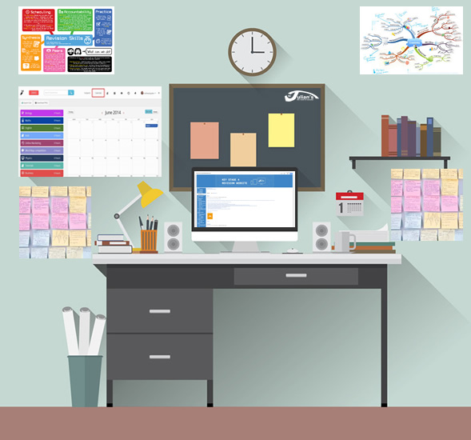
Parents - Finding the right environment
Get your child to switch off their mobile phone and allow them access to the internet only for revision sites. Social networking sites really should be discouraged as chatting can very easily lead to hours of valuable revision time being lost. Quick catch ups if absolutely essential should be planned during scheduled breaks only.
Ensure that he or she is working in a nice quiet room. If possible, ensure that the workspace has:
plenty of fresh air
natural light and a desk lamp
desk space that is large, but not in front of the window
near a radiator
resources/equipment nearby
a good chair
timetables and plans on a notice board

Slide 6
Parents - Planning
The secret to doing well in exams lies in planning. You can help your child to create a clear revision plan and method of studying that will make them feel in control of their work.
One way of planning a revision schedule can be to take a copy of the weekly time plan that Is included at the back of this booklet and begin by blocking all the time out when the young person is busy. This could begin with when they are at school, when you have meal times and then structured events such as sports practice or music lessons; it is a good idea for young people to continue to do such activities to provide a break.
You may also block out the regular social events, for example, if your child always spends Saturday afternoon with their friends shopping or playing sport, block out that time too. Look at the time left and then consider if that is a good time to revise. A conversation should then be had with the child to decide if they have enough time to complete all their revision. You may find that looking at it in this way means it is your child who says they realise some activities have to be given up during the revision period.
Unlikely as this may sound, one thing to be wary of is your child doing too much revision early on. However, think of the number of people who start a fitness programme, do too much on the first day, feel awful the next day and as a result never go back to their exercises; it can be just the same with revision.
The best approach to revision is usually 'little and often'. If your child commits to doing 20 minute bursts of revision of a really high quality with no television on and no mobile phone for texting then three of these bursts can be far more effective than the child who spends two hours in their room with their text book open but does not get down to any study, being distracted instead by television and phone calls.
Students planning their revision often split into two groups. There is one group that always put planning their revision off to the next day until they reach the night before the exam and panic that they have not done any revision. At the other extreme is the child who spends hours putting together a perfect revision timetable, carefully spending an equal amount of time on each subject and colour coding their timetable; this then becomes the child’s safety blanket but almost as soon as it has been written, it is out of date and has to be repeated. The result is the young person spends more time planning than actually revising.

Slide 7
Parents - Support
You can support your child by helping them follow these tips:
Break revision time into small chunks- research has shown that many individuals can concentrate best for regular sessions of no longer than of 20 minutes.
Take a short break between sessions and have a drink.
In the evenings after school, plan to revise two subjects- these should be a combination of a subject considered to be a strength and a subject considered to be one of the weaker. (avoid comfort revising i.e. spending a disproportionate amount of time on easy topics)
Plan to revise specific topics in each subject, not everything at once.
Ensure that each session starts with tackling the most difficult bits.
Plan to cover each subject several times and revisit each one near to the exams.
Revising with the TV or radio on or with loud music is not a good idea.
Reading is not generally enough. Making brief notes in either words or pictures helps them to remember.
Ensure that revision includes working through plenty of past exam questions
Consider arranging for your child to work with a friend. This allows for testing each other and discussing/ explaining the topic in depth plan to spend time completing practice questions so that he/ she is used to doing things within a time limit

Slide 8
Parents - Top Tips
TOP TIP:
Write out lots and lots of short questions on a topic. Writing out the answers over and over will boost your child’s confidence, trigger thought patterns/links and focus revision. It really works!
TOP TIP:
Try learning a set of key words for a topic in a progression- perhaps 15 to 20 words maximum. When these are learnt, use the words to construct a flowchart and/or paragraph(s). This works too!

Slide 9
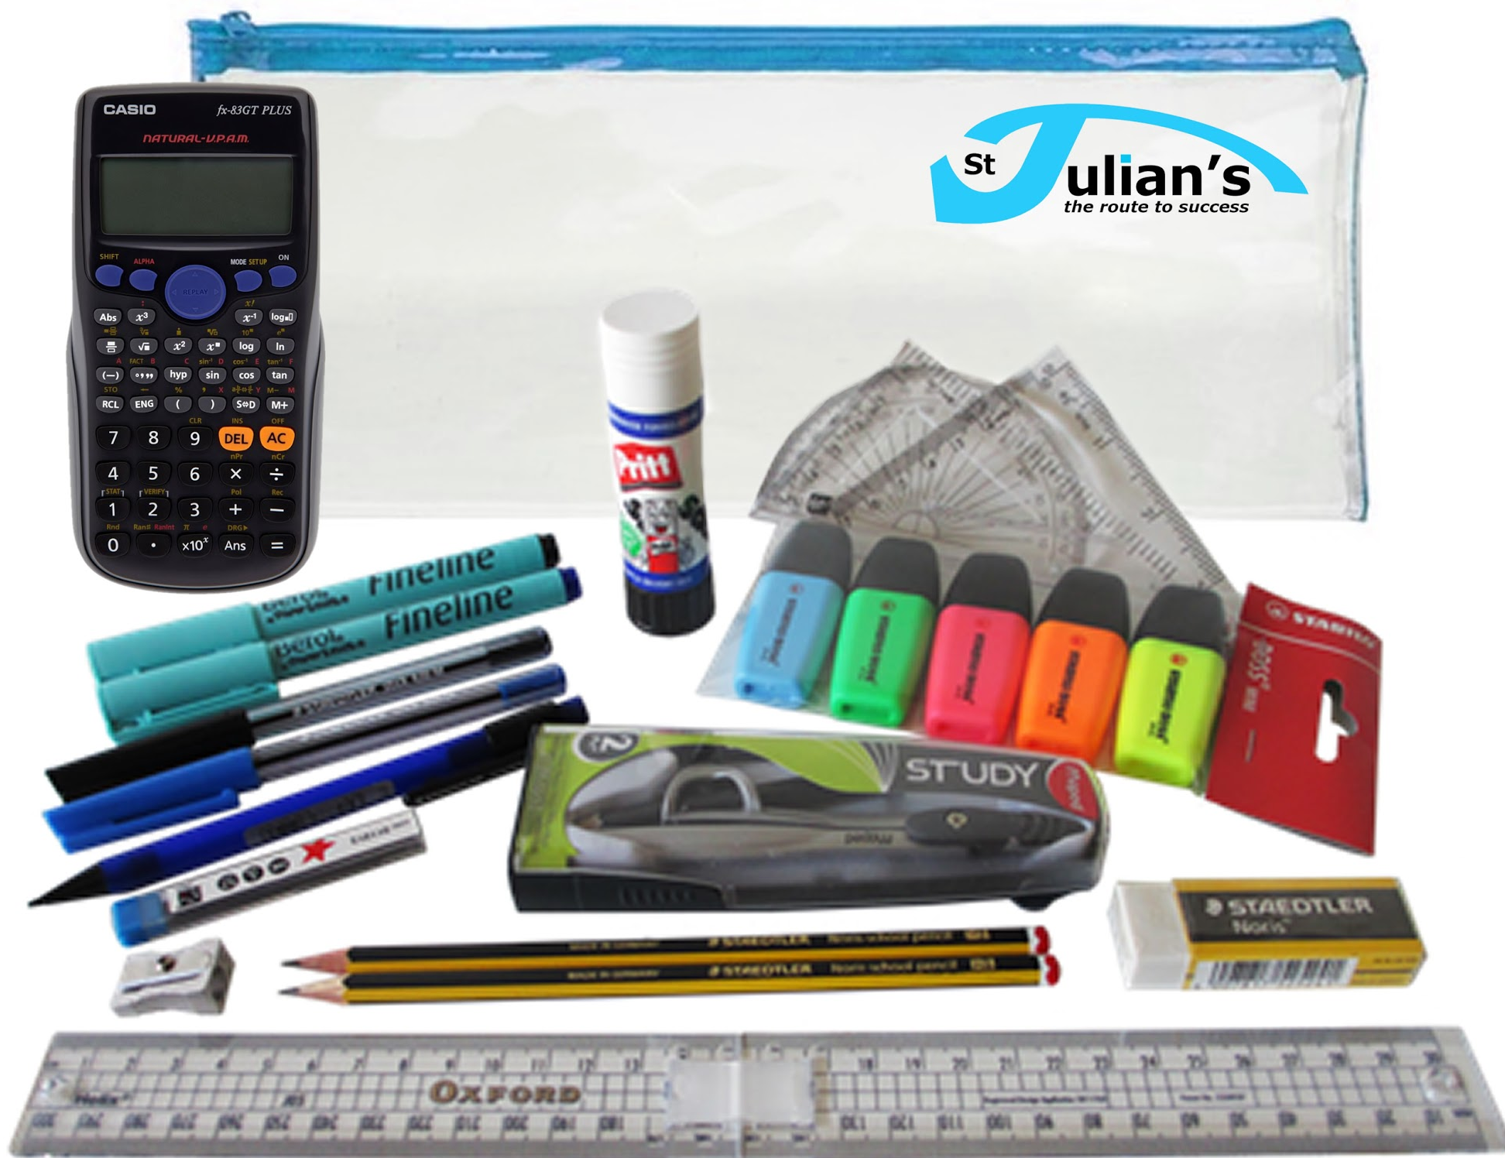
Parents - The exam period
It's important to get a good night's sleep before an exam, so discourage your child from staying up late to cram. And make sure he or she eats a good breakfast on the morning of the exam.
It may sound obvious but please ensure your child knows the times of every exam that day and allows plenty of time to get to school for the exam. Timetables have been issued by the school and replacements are available if required.
No mobile phones or any other electronic gadget (including MP3 players and smart watches) may be taken into the exam room. In addition correction fluid is not allowed.
Please remind them that they will need:
a couple of pens and sharp pencil
an eraser and ruler
a watch
a calculator and sometimes a protractor
bottle of water
small pack of tissues
This equipment should be carried in a clear
plastic pencil case or bag
Please inform the school if you are worried about
your child’s wellbeing in any way.

Slide 10
Parents - Exam technique
Downloading past papers from exam boards and attempting questions is an excellent way to prepare for the examinations. There is only a limited amount that can be asked and therefore, similar questions appear again and again using different scenarios. Website addresses for the exam boards can be found under the links section.
Examination questions can take a number of different approaches but most exam papers will include a combination of shorter factual questions and longer evaluative questions. It is vitally important that the question is read a number of times to ensure the correct approach is adopted and the correct information is provided.
The number of marks allocated will indicate how much information should be provided. In general, the shorter questions will attract a lower number of marks and will normally be looking for a fact or a description. The longer questions will attract a higher number of marks, sometimes as much as 10% of the total.
Useful generic revision websites:
BBC revision | www.bbc.co.uk/schools/gcsebitesize
S Cool (free revision website) | www.s-cool.co.uk
Revision Notes (free revision resources) | www.revision-notes.co.uk/GCSE/
U2 Learn (free fun learning) | www.u2learn.com
Revision Plans | www.myrevisionplan.co.uk
Revision World | http://www.revisionworld.co.uk

Slide 11
Parents - Helpful apps/websites
Brain Smart | BBC - Tips on memory and the brain | Website | LINK
Cram | Create online flashcards | App or website | LINK
Exam Countdown | Add your exams and see how many days there are left to revise | App | LINK
Flashcards+ | Create flashcards | App | LINK
Get Revising | Create study planner | Website | LINK
iMindMap | Create colourful mindmaps | App | LINK
Quizlet | Create online flashcards | Website | LINK

Slide 12
STUDENTS

Slide 13
Prepare to revise
Plan and use a revision programme/timetable
Develop the right mentality
Use all of your time effectively - WORK/REST/PLAY
Be successful because you worked for it
STEP #1
STEP #2
STEP #3
STEP #4
STEP #5

Slide 14
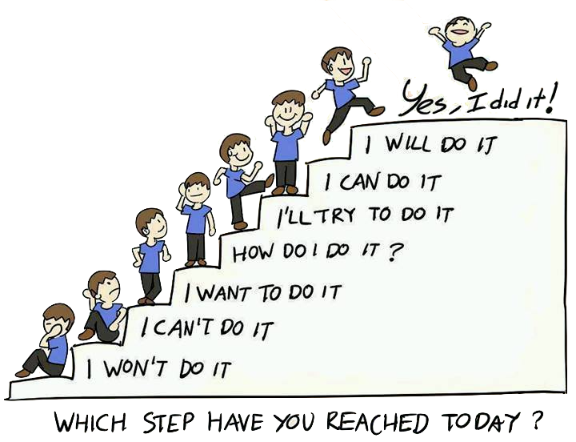

Slide 15
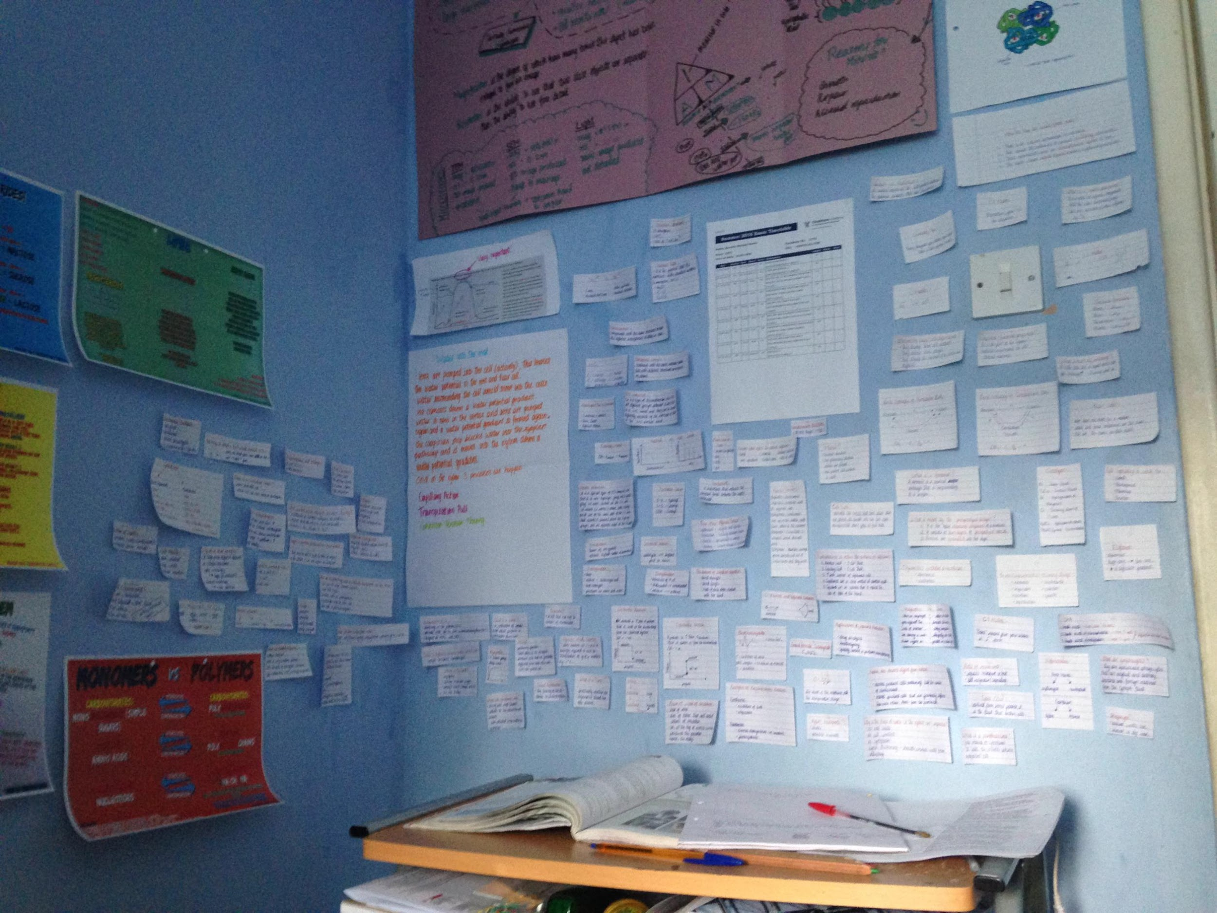
Prepare to revise
STEP #1
Choose somewhere that preferably is somewhere quiet and well lit, where you can keep your essentials:
lined paper
plain paper
index cards for note taking
plenty of Post-it notes
pens (multi-coloured)
pencil
ruler
eraser
highlighters
paper clips
folders
wallets
hole punch
calculator
computer access
desk lamp
timer/clock
bottle of water
subject specific equipment
Do this NOW or you will waste time, every time you sit down to revise, looking for the things you need.

Slide 16


Create the
right environment
Clutter free
Access to revision materials
Free from distractions
Set ground rules
Mobiles and social media OFF
Non negotiables
Be prepared to be flexible
DISTRACTIONS
Getting and staying motivated
Focus on short term task and long term goals
Set personal targets in your time and knowledge
Complete a learning audit
What are the key subjects?
Strengths and weaknesses
Traffics light topics
Prioritise revision

Slide 17

Plan and use a revision programme/timetable
STEP #2
Check which staff are in school running sessions over Easter
Map out which subjects you need to cover and their priority
Block in subjects and prepare to test yourself
Prepare to forget things and plan to re-learn work. You will not pick things up first time.

Slide 18
Revision timetable
 | MONDAY | TUESDAY | WEDNESDAY | THURSDAY | FRIDAY | SATURDAY | SUNDAY
09:00am
10:00am
11:00am
12:00pm
01:00pm
02:00pm
03:00pm
04:00pm
05:00pm
06:00pm
07:00pm
08:00pm
09:00pm
10:00pm

Slide 19
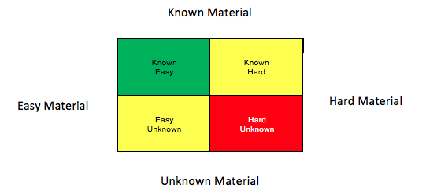
Improve your learning - Revision Priorities
“… As we know, there are known knowns; there are things we know we know. We also know there are known unknowns; that is to say we know there are some things we do not know. But there are also unknown unknowns - the ones we don't know we don't know.”
Donald Rumsfeld
· What are your ‘known knowns’?
(Things you know)
· What are your ‘known unknowns’?
(Things you know you don’t know)
· What are your ‘unknown unknowns’?
(Things you don’t know that you don’t know… did you miss a lesson? Did you fully read around? Did you skip a question that was too hard? – these will be your major downfall in an exam)
Think carefully about what material is a priority for revision. Many students pick topics that keep them in the ‘green zone’; easier material which they actually know and understand quite well. This reassures the student and gives a false confidence that they are prepared for examination. The priority must be the
‘red zone’, this is the hard material that is unknown to the student; this will result in the greatest gain.

Slide 20
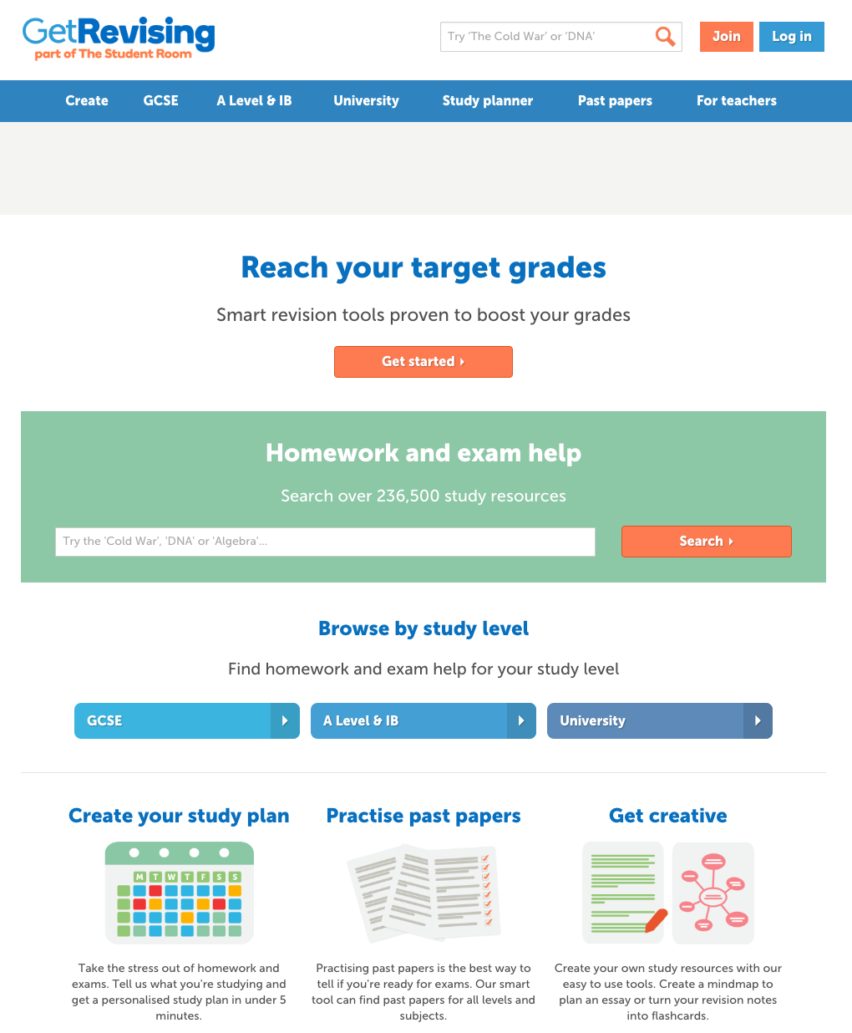
Write down a timetable and plan your work LINK

Slide 21
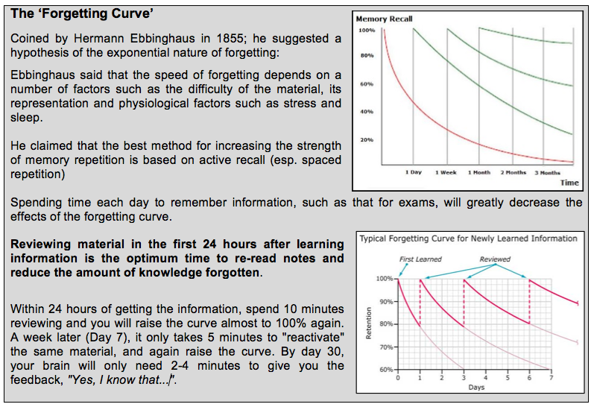
You will forget things! Learn how to deal with it

Slide 22
Develop the right mentality
STEP #3
IMPOSSIBLE
Demonstrate a growth mindset

Slide 23
Making an effort will make a difference
It’s never too late to improve
Not getting things fist time is an importnant part of learning
Ask yourself...
“What could I do differently next time to get more marks?”
Avoid making mistake so avoiding work/questions
Success in exams is down to being lucky
I have no influence in what I get in my exams
I’m no good at this subject so there’s no point
✓
ㄨ

Slide 24
Be careful what you say to yourself, as only you are listening...

Slide 25
Strive for progress,
not perfection

Slide 26
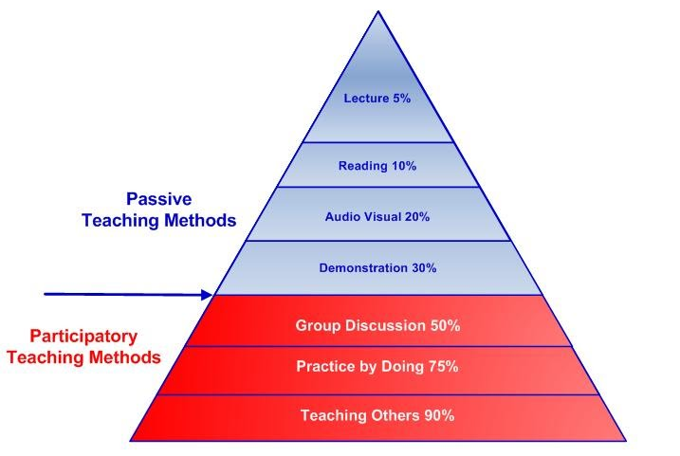
Use all of your time effectively - WORK/REST/PLAY
STEP #4
What this means is that if you sit and read your notes, then do nothing else with them, you will recall 10% of that information.
Be more effective with your time and techniques.
Plan to use the information in group discussion, self checking scenarios, practicing exam questions and teaching others.
If you cannot explain what you are learning to others, then you need to do some more work on that topic.

Slide 27




Memory games
Create acronyms
Songs & singing
Flash cards
Post-it notes
Keywords
YouTube & Podcasts
Past paper questions
Teaching someone else
Record your notes on phone
Mind mapping
See one, do one, teach one

Slide 28

Understand
Condense
Memorise
Review

Slide 29
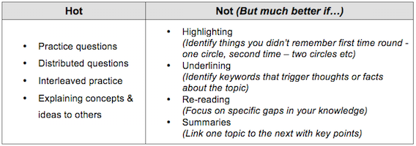

Good revision practice
Learning Chains
Study A
Test A
Study B
Test A+B
Study C
Test A+B
Study D
Test B+C
Study E
Test A+D

Slide 30
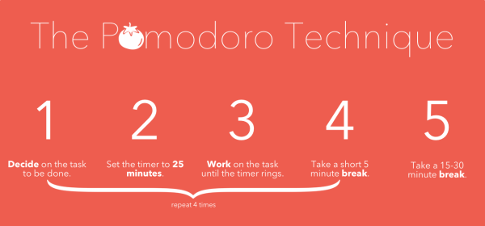
The Pomodoro technique is a productivity system that promises to help you eliminate distractions, avoid burnout and create a better work/life balance. The user sets a timer to alternate between periods of intense focus on work and complete separation of all things work related. Generally, before setting your timer and starting your first Pomodoro, you set up a “To-Do” list of things to accomplish, and work them in order of priority. Once one item is completed, it is checked off the list and the next item becomes your priority.
Each Pomodoro takes 30 minutes total – 25 minutes of work and 5 minutes of play. Once you complete your 25 minutes of focused work, a check mark is made on a notepad, and you are now free to do something completely separate from your work, whether it be a walk, stretching, whatever….spend 3-5 minutes completely disengaged from your work. After the break you reset the timer and get back to work. After four Pomodoro’s you then give yourself a 15-30 minute break.
Here’s the thing, since your 25 minutes are meant to be hyper-focused on work, you are actually likely to get more done than you would were you just to do your normal routine of interspersing work with other things.

Slide 31
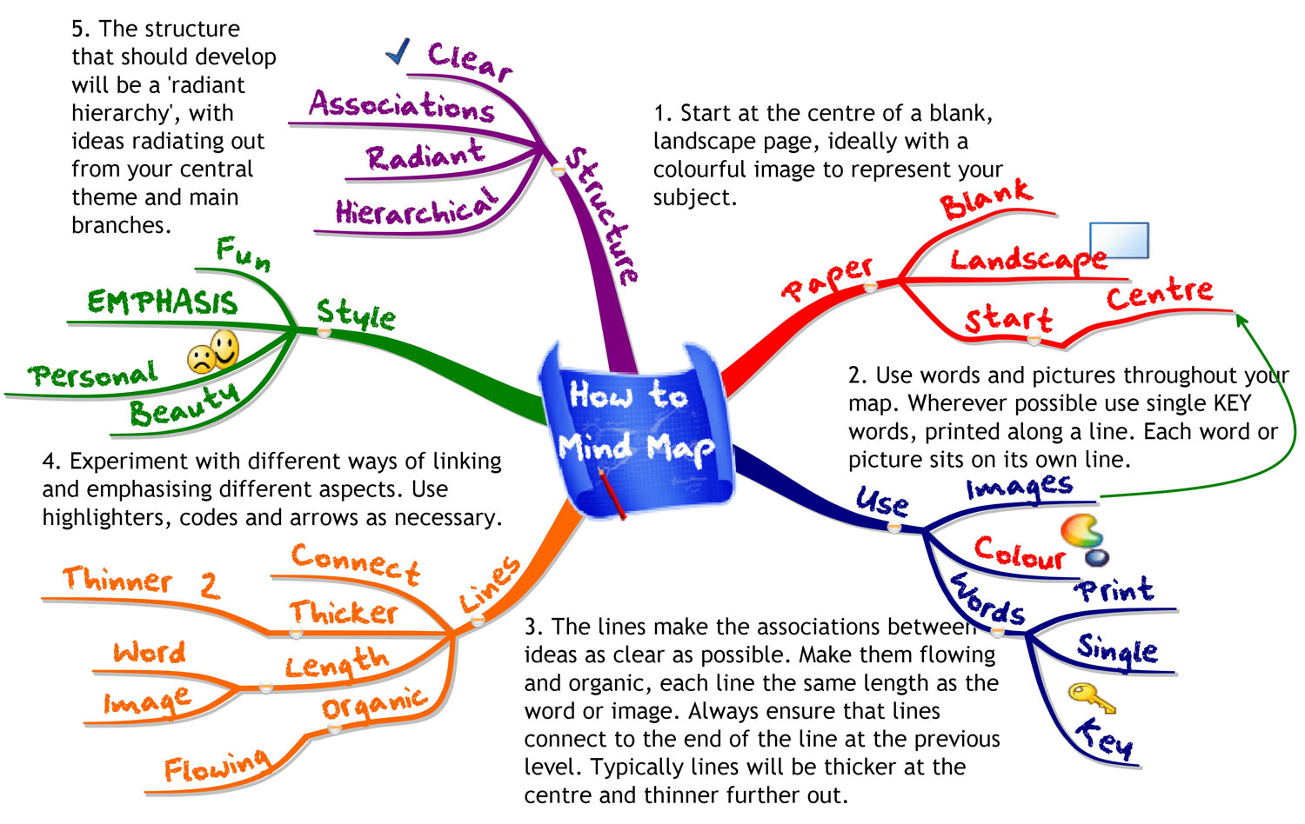

Slide 32
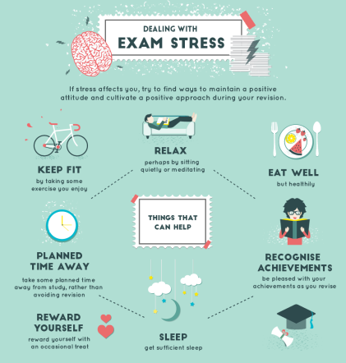
Be successful because you worked for it
STEP #5
Who can help?...
Subject teachers
Form tutor
Head of House
Parents
Friends

Slide 33

Before the exam
✓ Write all your exams on a calendar and know the start time. Is it in the morning or afternoon, and where is it?
✓ Be prepared - get your bag packed with your pencil case and notes the night before
✓ Know how long the exam lasts so you can pace yourself
✓ Keep revision light on the day of the exam. Put the time in before hand.
✓ Arrive in good time and do what
works for you - find a quiet
space to focus and avoid
distractions and talking
about the exam before
you go in
During the exam
✓ Take deep breaths
✓ Use all the time available
✓ Read the instructions carefully
✓ Don’t panic over any questions, move on to the next one and come back to it
✓ Look for the command words about what you need to do - eg. evaluate, describe, explain, analyse, justify etc.
✓ Be aware of the number of marks for each question and ensure you are answering the question, not just what you know

Slide 34
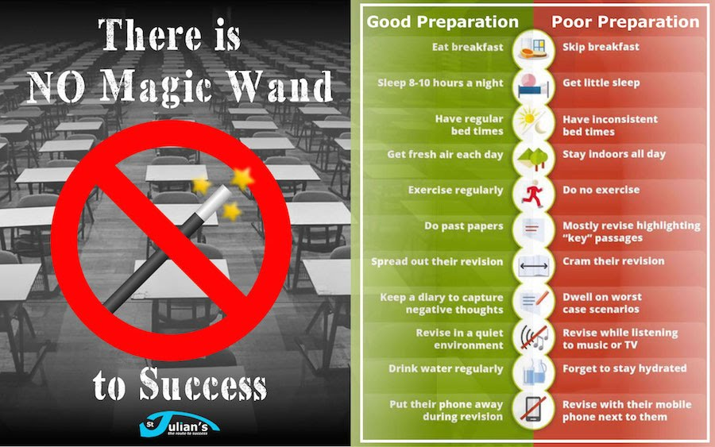

Slide 35
1
stamina
[stam-uh-nuh]
noun
Great physical or mental strength that allows you to continue doing something for a long time.
To endure...

