Slide 1

Why Study Art?

Slide 2

Common misconceptions around Art
“Your artwork has to be precise and realistic”
“I’ve heard that good Artwork takes too much time to create”

Slide 3

Common misconceptions around Art
“You have to learn about Art History”
“The teachers expect you to know how to use all the materials”
“Choosing A Level Art means you won’t have any time to socialise”

Slide 4
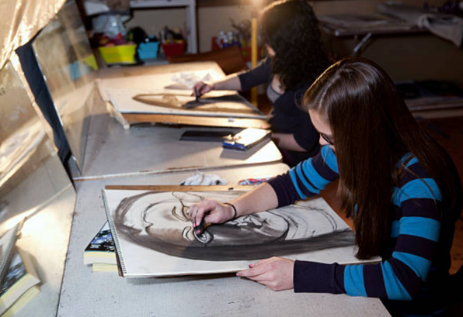
Common misconceptions around Art
“A-Level Art won’t get me into university - it is a waste of time and won’t get me anywhere”
“A-Level Art won’t look good on my C.V. or application forms”

Slide 5

Common misconceptions around Art
“My friends say that ‘Art’ will not get me anywhere and I should just do it in my spare time”

Slide 6

Why Study Art?
Explore and represent the world we live in.
Express your own thoughts and opinions.
Develop problem-solving skills.

Slide 7
Why Study Art?
Transferable skills – be open to explore and experiment not only with materials but also with ideas.
Develop your individual approach to art, craft and design.

Slide 8
Why Study Art?
Be exposed to culture, tradition and upcoming trends through visiting museums, galleries and art shows.
For your well-being: Art = a therapeutic output.
Fastest growing industry in the UK!

Slide 9

Why Study Art?
Listen and watch what creative practitioners have to say about Art in this video by Tate:
https://youtu.be/vKjkx6PzajE

Slide 10

What can you do with Art and Design?
Explore and learn more about social, moral, cultural, historical and political issues.
Be a more ‘worldly’ and open minded individual.

Slide 11

What can you do with Art and Design?
Learn to become a problem solver - Graduate employers want to recruit people who are lateral thinkers and creative problem-solvers.
Universities look for interesting, diverse applicants who can think outside the box and show passion!

Slide 12
TASK: How can art develop your character?

Slide 13

Developing Character and Culture:
What transferrable skills does Art & Design give you?
Imagination
Creativity
Organisation
Resourcefulness
Social skills
Problem-solving
Decision-making
Team work

Slide 14
Developing Character and Culture:
What transferrable skills does Art & Design give you?
Self-motivation
Work independently
The ability to be reflective
Give constructive criticism
Oral communication
Written communication
Visual presentation

Slide 15
TASK: What jobs could Art support?

Slide 16
What Careers can Art take me into?
App Designer
Architect
Art Therapist
Book Illustrator
Cake decorator
Ceramics designer
Gallery conservator
Comic Book Creator
Costume designer
Digital imaging
Fashion designer
Film Producer
Florist
Exhibition designer
Community arts worker

Slide 17
What Careers can Art take me into?
Glass Blower
Graphic designer
Hairdresser
Product designer
Interior designer
Jewellery designer
Make-up artist
Model maker
Photographer
Floral designer
Printmaker
Production designer
Prop maker
Street Artist
Stylist
Textile designer
Set designer
Software designer
Furniture designer/restorer

Slide 18
For more information on how to get a job in an Art and Design career, you could watch:
https://www.youtube.com/watch?v=zf_tBRvCczo

Slide 19
What could you research next?
For more information on Creative Industries in the UK:
http://www.thecreativeindustries.co.uk/resources/infographics
Information on careers in Art and Design:
https://icould.com/explore/subject/art+and+design
Watch a video on someone in the Art and Design Career:
https://www.careersbox.co.uk/blog/

Slide 20

Commissioned by The PiXL Club Ltd. May 2019
This resource is strictly for the use of member schools for as long as they remain members of The PiXL Club. It may not be copied, sold, or transferred to a third party or used by the school after membership ceases. Until such time it may be freely used within the member school.
All opinions and contributions are those of the authors. The contents of this resource are not connected with, or endorsed by, any other company, organisation or institution. These papers were made by teachers in good faith based upon our understanding to date.
PiXL Club Ltd endeavour to trace and contact copyright owners. If there are any inadvertent omissions or errors in the acknowledgements or usage, this is unintended and PiXL will remedy these on written notification.

