Slide 1

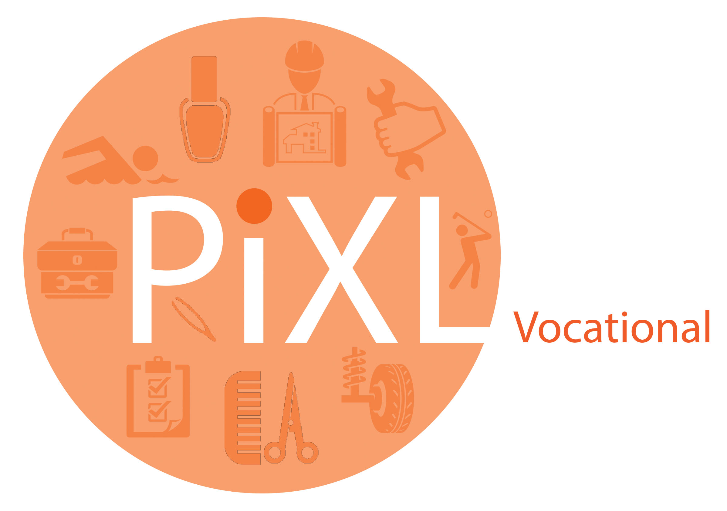
Vocational Courses in
Sixth Form

Slide 2
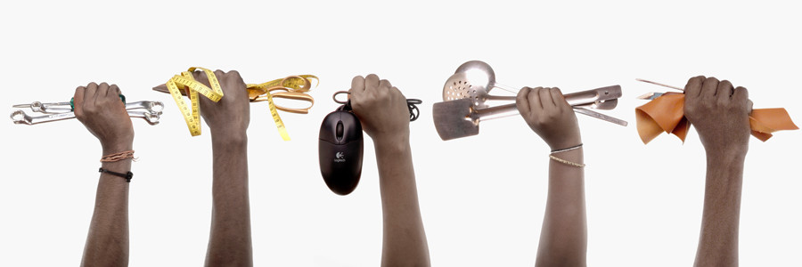
Why study a vocational qualification?
Vocational courses are designed to help you learn in a practical way about a specific job area. They can help you get the skills you need to start a job, progress in a career or go on to higher education.

Slide 3
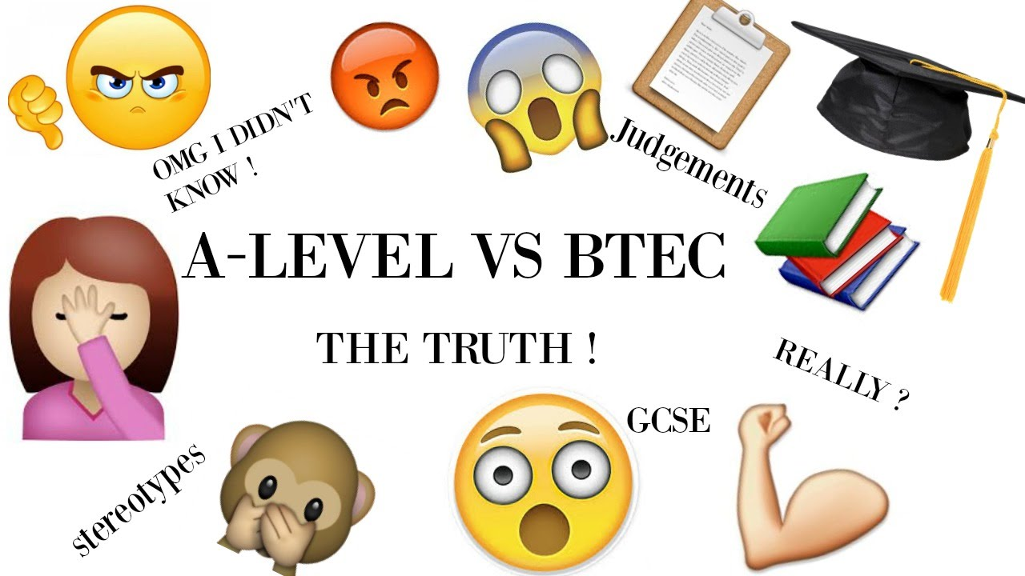
They are recognised by the Government as a direct equivalent to A Levels. Vocational qualifications often come in varying sizes at sixth form and college. This means you can study the equivalent of several A Levels in one vocational area, making you an expert in your field.

Slide 4

They count for entry requirements to University and Higher Level Apprenticeships.

Slide 5

Why study a vocational course?
They provide an opportunity to build practical skills, as well as traditional classroom learning, perfect for higher education and work-based learning.

Slide 6

What are the common misconceptions about vocational qualifications?
Myth 1: Vocational Qualifications are just for trades
Not true, there are courses in law, web development, criminology, business, psychology and digital interactive games. As you may know, apprenticeships are available to learn a trade like carpentry or welding. But there are also traineeships — these are vocational qualifications too. You can do things like graphic design, business administration or tourism. There are so many options!

Slide 7


Myth 2: Studying a vocational course will not gain you any credit for University or Higher Level Apprenticeships
Vocational courses are full integrated into the school curriculum and are viewed by the Government as a direct equivalent to A Levels. They do give you credit when moving to University or Higher Level Apprenticeships.

Slide 8

Myth 3 Vocational courses are for lower achieving students
Again, completely untrue. Most vocational qualifications now have a consistent blend of academic and vocational skills that are tested. Success in these subjects is viewed just as highly as A Levels. Some schools even insist on their students taking a vocational qualification alongside their A Level or IB alternatives.

Slide 9
So what can you do with them?
Vocational qualifications are designed to lead to a job, an area of employment and/or further study. They can be an attractive option to help prepare you for the world of work and a particular job or employment sector.
Vocational qualifications and apprenticeships are being developed across most professions, for example: science, law, finance, media and IT.
Vocational qualifications can help you prepare for a very specific job or give you a broad overview of a job sector.
Most importantly, Vocational qualifications keep your options open for:
Further Study
Workplace/Apprenticeships

Slide 10
How do vocational qualifications deliver character and culture?
Because of their format, Vocational courses build character and embed a culture of self-discipline through developing time management skills. The heavily weighted coursework element of the qualifications encourage huge independence skills (vital for higher education or the world of work), whilst also encouraging a thirst for knowledge and the development of research skills, requiring students to independently find and assimilate research they have found.
The externally assessed components of the course teach students the value of revision and understanding key concepts, skills that both higher education and employers hold in high regard.
This is just the start, but what is clear is that Vocational courses give students the skills they require to cope effectively with working in the modern world and for their future careers.

Slide 11

Where to now?
What is important to understand is where Vocational qualifications can take you in the future … the answer is pretty much anywhere you want to go!

Slide 12
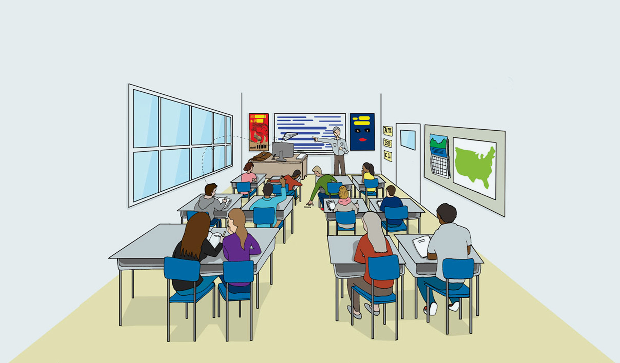
Remember, Vocational qualifications are recognised equivalents to A Levels and will directly contribute to your entry requirements for Higher Level Apprenticeships and University.

Slide 13
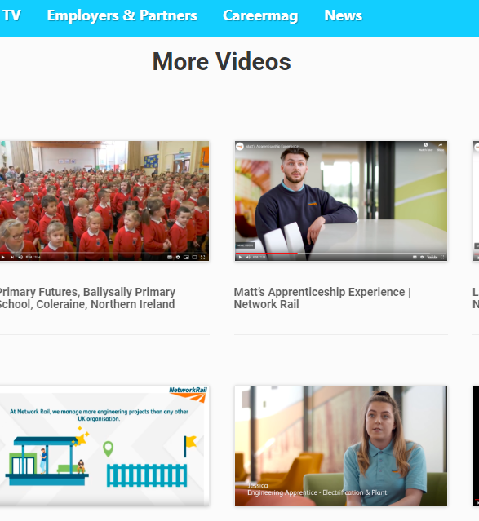
Career Map TV showcases a whole host of successful young students who have channelled their talents into the world of work after studying vocational qualifications at school. Click the link below to see a range of videos, from engineering, business, health and social care, accounting, project management and more.
https://careermap.co.uk/careermap-tv/

Slide 14
© The PiXL Club Ltd. July 2019
This resource is strictly for the use of member schools for as long as they remain members of The PiXL Club. It may not be copied, sold, or transferred to a third party or used by the school after membership ceases. Until such time it may be freely used within the member school.
All opinions and contributions are those of the authors. The contents of this resource are not connected with, or endorsed by, any other company, organisation or institution. These papers were made by teachers in good faith based upon our understanding to date.
PiXL Club Ltd endeavour to trace and contact copyright owners. If there are any inadvertent omissions or errors in the acknowledgements or usage, this is unintended and PiXL will remedy these on written notification.

