Slide 1


Why Study Geography?
Facilitating skills for the workplace and university

Slide 2

Facilitating subjects
The Russell Group suggest that a group of facilitating A levels enable students to have a range of skills that are transferable to the workplace and also university.
They are:
Chemistry
Physics
Biology
Maths
5. Geography
6. History
7. English literature
8. Languages

Slide 3

Why is geography considered facilitating?
Problem-solving
High in numeracy and literacy skills
Encourages working well and integrating with others
Promotes empathy

Slide 4

Why is geography considered facilitating?
Knowledge about different economies and world populations.
Flexes and supports many other subjects.
These skills make geography one of the most employable subjects.

Slide 5

Where will geography take
you?
“The study of geography is about more than just memorising places on a map. It’s about understanding the complexity of our world, appreciating the diversity of cultures that exists across continents. And in the end, it’s about using all that knowledge to help bridge divides and bring people together.”
Barack Obama

Slide 6

Geography will develop your character and culture

Slide 7

Leadership skills
Geography enables you to understand the importance of both empathy and evidence-based decision making in effective leadership.
It helps you understand that different people are motivated in different ways.
You learn from your mistakes but also previous mistakes made by others that you learn about.
You can critically think about how you can develop leadership skills to achieve others and your own future goals!

Slide 8

Organisational skills
Geography helps students understand that organised thinking can improve problem solving skills. A key transferable skill!
It enables you to understand that strong organisational skills require a mixture of methodical working and flexibility.
Geography can help you organise your thoughts on how to approach challenges with a clear head.
Assessing is a key skill in geography so the ability to between distinguish between what is important and what isn’t.

Slide 9
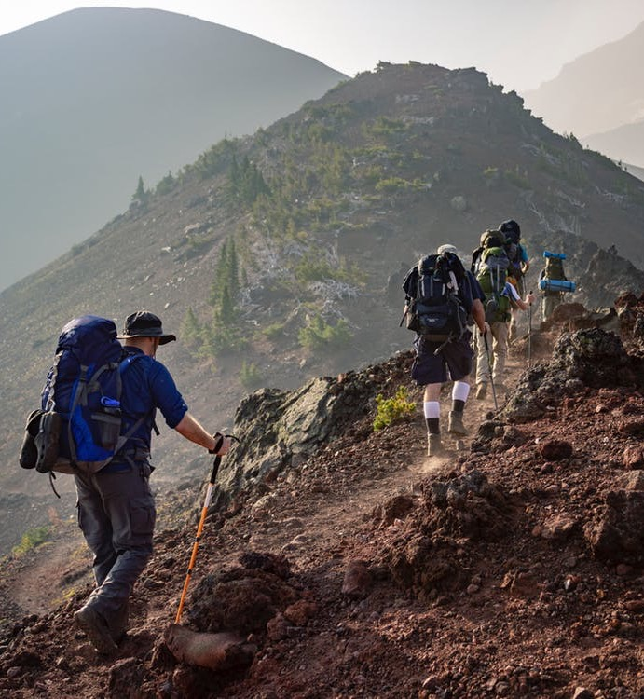
Resilience skills
Geography looks at areas where countries or leaders have shown resilience and therefore can identify the common barriers that make people want to give up.
It enables you to understand the difference between self-evaluating and self-criticising. Evaluation is a key high order skill for geographers!
The subject looks at problems and can focus on change of demands. For example in water and energy security.

Slide 10

Initiative skills
Geography helps you understand how using initiative can help with creative problem solving.
Through your NEA you gain understanding that continual challenge leads to improvement.
Through flipped learning and case studies you can show how you work independently and have strategies for finding answers about world issues.
With many branched to geography, the subjects lets you seek opportunities to further your learning in an area of interest.

Slide 11

Communication skills
Essential justification and evaluation questions in geography help with understanding the difference between disagreeing with people and disagreeing with opinions. Stakeholders and players involved are key at KS5.
NEA and presentation skills in geography stretch your ability to communicate information in a number of different ways. Not just verbally.
Analysing texts in geography aids the ability to distinguish between ‘content’ and ‘rhetoric’ to make the best judgement.

Slide 12
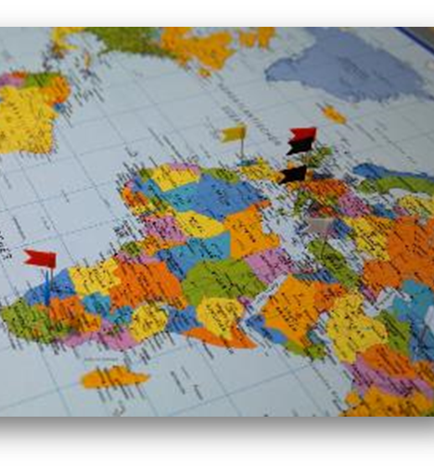
Common misconceptions
Geography careers are not just weather forecaster and geography teacher
Geography is not just useful to professional geographers
There is so much more…

Slide 13

TASK:
List as many jobs as you can that Geography could support

Slide 14
Example jobs Geography can support
Transport planner (such as working for TFL)
Teacher
Lawyer
Travel advisor
Flood risk coordinator
Urban regeneration and town planner
Work for an energy supplier
Armed forces

Slide 15

Example jobs Geography can support with
Meteorologist
Hazard and crisis manger
Journalist
Humanitarian worker
Landscape architect
Surveyor
Environmental campaigner
Civil servant

Slide 16
Example skill from geography
Statistical analysis is essential to many jobs:
Banking, trading, website design, retail mangement, project design, sports promoter and many more!

Slide 17

Finding out about geography degrees and careers in geography
For information on geography degrees:
https://www.topuniversities.com/student-info/careers-advice/what-can-you-do-geography-degree
Comparing geography degree course:
https://university.which.co.uk/subjects/geography
Why study geography? https://www.rgs.org/geography/studying-geography-and-careers/geography-at-university/why-study-geography/
Why do a geography degree? https://www.thecompleteuniversityguide.co.uk/courses/geography-environmental-science/six-reasons-to-study-geography-environmental-science/

Slide 18

Commissioned by The PiXL Club Ltd. May 2019
This resource is strictly for the use of member schools for as long as they remain members of The PiXL Club. It may not be copied, sold, or transferred to a third party or used by the school after membership ceases. Until such time it may be freely used within the member school.
All opinions and contributions are those of the authors. The contents of this resource are not connected with, or endorsed by, any other company, organisation or institution. These papers were made by teachers in good faith based upon our understanding to date.
PiXL Club Ltd endeavour to trace and contact copyright owners. If there are any inadvertent omissions or errors in the acknowledgements or usage, this is unintended and PiXL will remedy these on written notification.

