Slide 1
THE YELLOW WALLPAPER
Literature Enrichment 1
Charlotte Perkins Gilman 1890

Slide 2

SESSION 1
Introduction and Literary Theories

Slide 3
Inference versus deduction
To infer is to make guesses based on clues. They don’t have to be right.
To deduce is to come to the right answer based on the clues, like Sherlock Holmes does.
Inference: Think about the title – The Yellow Wallpaper – what do you think the story will be about and why?
Deduction: Now what can you deduce about the narrator from the first line of the story:
“It is very seldom that mere ordinary people like John and myself secure ancestral halls for the summer.”

Slide 4
Inference versus deduction
To infer is to make guesses based on clues. They don’t have to be right.
To deduce is to come to the right answer based on the clues, like Sherlock Holmes does.
Inference: Think about the title – The Yellow Wallpaper – what do you think the story will be about and why?
Deduction: Now what can you deduce about the narrator from the first line of the story:
“It is very seldom that mere ordinary people like John and myself secure ancestral halls for the summer.”
She’s a married woman.
Her husband’s name is John.
She isn’t used to staying in big houses.
She probably middle class.
A big house once belonging to a family member.

Slide 5
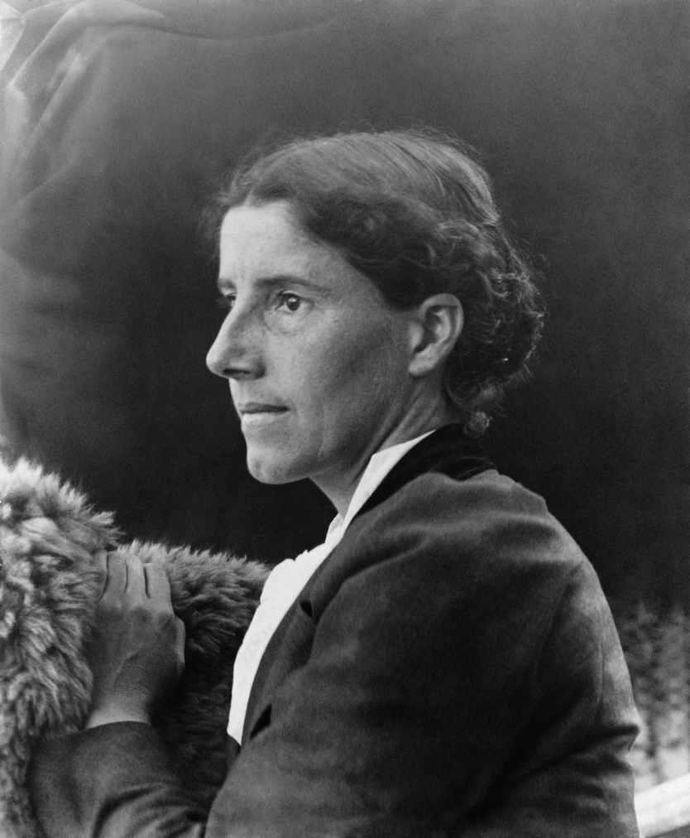
Charlotte Perkins Gilman was best known in her time as a crusading journalist and feminist intellectual. Gilman was concerned with political inequality and social justice in general, but the primary focus of her writing was the unequal status of women within the institution of marriage.
In her writing (mainly non-fiction), she argued that women’s obligation to remain in the domestic sphere robbed them of the expression of their full powers of creativity and intelligence, while simultaneously robbing society of women whose abilities suited them for professional and public life.
An essential part of her analysis was that the traditional power structure of the family made no one happy—not the woman who was made into an unpaid servant, not the husband who was made into a master, and not the children who were subject to both.
Notes:
Task: Can you ‘translate’ each paragraph into your own words?

Slide 6
Charlotte Perkins Gilman was best known in her time as a crusading journalist and feminist intellectual.
Gilman was concerned with political inequality and social justice in general, but the primary focus of her writing was the unequal status of women within the institution of marriage.
In her writing(mainly non-fiction), she argued that women’s obligation to remain in the domestic sphere robbed them of the expression of their full powers of creativity and intelligence, while simultaneously robbing society of women whose abilities suited them for professional and public life.
An essential part of her analysis was that the traditional power structure of the family made no one happy—not the woman who was made into an unpaid servant, not the husband who was made into a master, and not the children who were subject to both.
Charlotte Perkins Gilman was feminist journalist with a mission.
She was concerned with how unfair society and politics were, but she mainly focused on how women were treated unfairly in marriages because of the idea marriage.
She argued that because women were expected to be housewives, they were unable to be creative or stretch their intelligence. She thought that this was unfair for women and for the whole of society, as women could be more useful if they were allowed to have ‘proper’ jobs.
She argued that the traditional expectations of men and women made everyone unhappy as women didn’t want to be servants, not all men wanted to ‘rule’ over their family, and children would have unhappy parents.
Notes:
A translated version

Slide 7
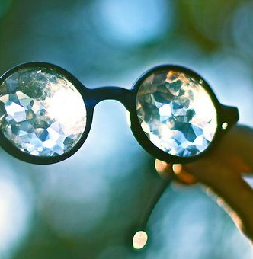
CRITICAL LITERARY THEORY
When reading literature, you will read it through your own eyes. You will have a different reaction to what you read based on your experiences and ideas.
At A Level, you have to put on ‘literary theory glasses’ and read through different lenses.
Our theory is feminism.

Slide 8
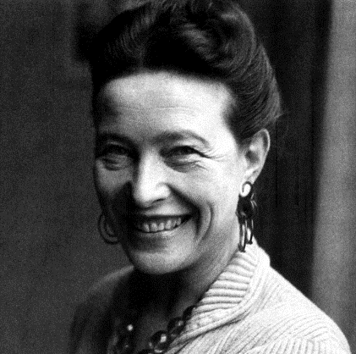
Reading through a feminist lens, you should pay attention to the following:
How are female characters presented compared to male characters?
How do you react to what you read, based on your gender?
Gender is restrictive, so how are female characters restricted by their gender?
How are society’s expectations of women presented in the text?
How do male and female writers present gender?
Simone du Beauvoir (a famous French Feminist writer) believed that:
  Society expects each gender to behave in a distinct way.
  Women are oppressed as they are only valued for their looks and their societal function as wives and mothers.
  Women are ‘the second sex’ as they are seen as less powerful and important to men.

Slide 9
Feminism key vocabulary: Can you match the word to its definition?
Submissive | strengthen or support
Dominant | relating to a widely held but fixed and oversimplified image or idea of a particular type of person or thing.
Reinforce | ready to conform to the authority or will of others
Subvert | Most powerful
Patriarchal | undermine the power and authority of (an established system or institution).
Stereotypical | Controlled by men

Slide 10
Feminism key vocabulary
Reinforce | strengthen or support
Stereotypical | relating to a widely held but fixed and oversimplified image or idea of a particular type of person or thing.
Submissive | ready to conform to the authority or will of others
Dominant | Most powerful
Subvert | undermine the power and authority of (an established system or institution).
Patriarchal | Controlled by men
Notes:
Answers

Slide 11

Put your feminist glasses on and read this text, asking yourself those feminist literary theory questions.
Challenge: Use some of the key vocabulary to express your ideas.
Notes:
Reminder of the feminist literary theory questions:
How are female characters presented compared to male characters?
How do you react to what you read, based on your gender?
Gender is restrictive, so how are female characters restricted by their gender?
How are society’s expectations of women presented in the text?
How do male and female writers present gender?

Slide 12
Where The Wild Things Are Maurice Sendak
The night wore his wolf suit and made mischief of one kind and another his mother called him “WILD THING!” and Max said “I’LL EAT YOU UP!” so he was sent to bed without eating anything.
That very night in Max’s room a forest grew and grew and grew until his ceiling hung with vines and the walls became the world all around and an ocean tumbled by with a private boat for Max and he sailed off through night and day and in and out of weeks and almost over a year to where the wild things are.
And when he came to the place where the wild things are they roared their terrible roars and gnashed their terrible teeth and rolled their terrible eyes and showed their terrible claws till Max said “BE STILL!” and tamed them with the magic trick of staring into all their yellow eyes without blinking once and they were frightened and called him the most wild thing of all and made him king of all wild things.
“And now,” cried Max, “let the wild rumpus start!”
“Now stop!” Max said and sent the wild things off to bed without their supper.
And Max the king of all wild things was lonely and wanted to be where someone loved him best of all. Then all around from far away across the world he smelled good things to eat so he gave up being king of where the wild things are.
But the wild things cried, “Oh please don’t go we’ll eat you up - we love you so!”
And Max said, “No!”
The wild things roared their terrible roars and gnashed their terrible teeth and rolled their terrible eyes and showed their terrible claws but Max stepped into his private boat and waved good-bye and sailed back over a year and in and out of weeks and through a day and into the night of his very own room where he found his supper waiting for him and it was still hot.

Slide 13
WHERE THE WILD THINGS ARE
How are female characters presented compared to male characters?
How do you react to what you read, based on your gender?
Gender is restrictive, so how are female characters restricted by their gender?
How are society’s expectations of women presented in the text?
How do male and female writers present gender?

Slide 14
WHERE THE WILD THINGS ARE
How are female characters presented compared to male characters?
There is only a mother, no father – where is he? In work? Does the mother work or is she only a mother? Max is a male and he dominates once he reaches the wild things. Would that have happened if he were a female?
How do you react to what you read, based on your gender?
As a women, it makes me angry as it’s a children’s book reinforcing stereotypical gender role of male dominance and female submissiveness.
Gender is restrictive, so how a female characters restricted by their gender?
Is she ‘just a mother’? She’s cooking. She’s not the one who escapes.
How are society’s expectations of women presented in the text?
Female = servant; male = ruler.
How do male and female writers present gender?
He is a male writer, in the 1960s, so we must take this into account too.

Slide 15
END OF SESSION 1

Slide 16
SESSION 2
The Plot

Slide 17
Recap
Summarise what Charlotte Perkins Gilman argued through her writing in one sentence.
Summarise feminist literary theory in once sentence.

Slide 18
Recap
Summarise what Charlotte Perkins Gilman argued through her writing in one sentence.
Summarise feminist literary theory in once sentence.
CPG argued that trapping women in the domestic sphere restricted their creativity and made society worse.
Feminist literary theory explores the role of gender in the writing and interpretation of texts.

Slide 19
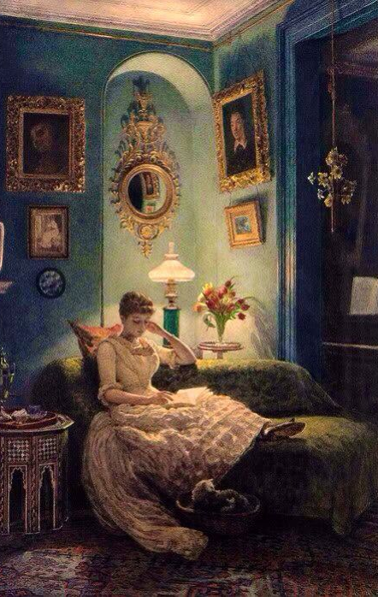
Read the text through from beginning to end.
The text is attached as a PDF document to the assignment details.
If you like, there’s an audiobook version linked there too, so you can listen to someone read it as you follow.
The Yellow Wallpaper - Audio Recording Youtube

Slide 20
Answer these questions to check your understanding…
Page 4
Explain (as best you can!) what is wrong with the narrator and what she has been advised to do.
She doesn’t agree with this advice. What does she think would improve her condition?
Page 5
Think about the setting – specifically the house. What is mysterious about its past?
What do we learn about their marriage?
Page 6
Just before the ‘break’ at the bottom of the page we discover a little more about the narrative. How do you think the narrator is recording the story?
Page 7
Who is Mary?
Page 8
“I think sometimes that if I were only well enough to write a little it would relieve the press of ideas and rest me.” What do you think the narrator means by this?
Page 9
What is the narrator seemingly obsessed with?
Notes:
Think about the answers to these questions - you may want to make notes on them.

Slide 21
Answer these questions to check your understanding…
Page 10
Just before the ‘break’, what does the narrator believes she sees in the wallpaper?
Page 11
“I lie here on this great immovable bed – it is nailed down, I believe – and follow that pattern about by the hour.” How does this line make you feel about the narrator?
Page 13
What does the narrator see in the wallpaper? What does this suggest about her state of mind?
Page 18
The narrator discusses the smell which, she believes, comes from the wallpaper. What technique does she use to make it seem horrific? How is it effective?
Page 20
After the break, how does the narrator present her relationship with John now? How is it different?
Page 22
“I wonder if they all came out of that wallpaper as I did?” Who does the narrator now believe she is?

Slide 22
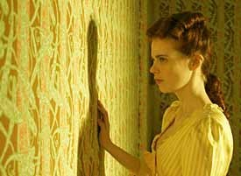
Reflection
Think about what you’ve read.
Make a note of how you could apply a feminist reading to this story, as you did with Where The Wild Things Are.
We will ‘discuss’ this at the beginning of the next session.

Slide 23
END OF SESSION 2

Slide 24
SESSION 3
Symbolism

Slide 25
Feminist Literary Theory
Can you apply a feminist reading to the following?
The character of John?
The female narrator?
The baby?
What happens at the very end of the story?.
What is CPG suggesting about women's creativity?
Notes:
John = control and sanity versus the narrator’s increasing madness.
Restricting creativity – her active mind found creativity elsewhere (in making up the stories behind the wallpaper.
Postpartum depression?

Slide 26
Feminist Literary Theory
John: a symbol for the patriarchy?
Women need to rest – thinking will make them worse.
She doesn’t have a voice, so writes in secret.
The baby: not ‘my’ baby – rejecting the role of mother?
Subversion: It’s John who faints at the end, rather than what would have typically happened in Victorian literature.
Is CPG suggesting that to restrict women's creativity can ‘drive them mad’? Women need intellectual stimulation.
Notes:
John = control and sanity versus the narrator’s increasing madness.
Restricting creativity – her active mind found creativity elsewhere (in making up the stories behind the wallpaper.
Postpartum depression?

Slide 27
Symbolism: the use of symbols to signify ideas
Look through the text for descriptions of these aspects of setting.
What do you think they symbolise?
Consider the following questions to help you:
What do they suggest about the narrator’s position?
What do they imply about her state of mind?
What do they suggest about her position in society?
How do they link to what we’ve discussed about feminism in the text?
    The Setting
    The house
    The bed
    The garden
    The nursery
Notes:
You could brainstorm your ideas about the different symbols and what you think they represent

Slide 28
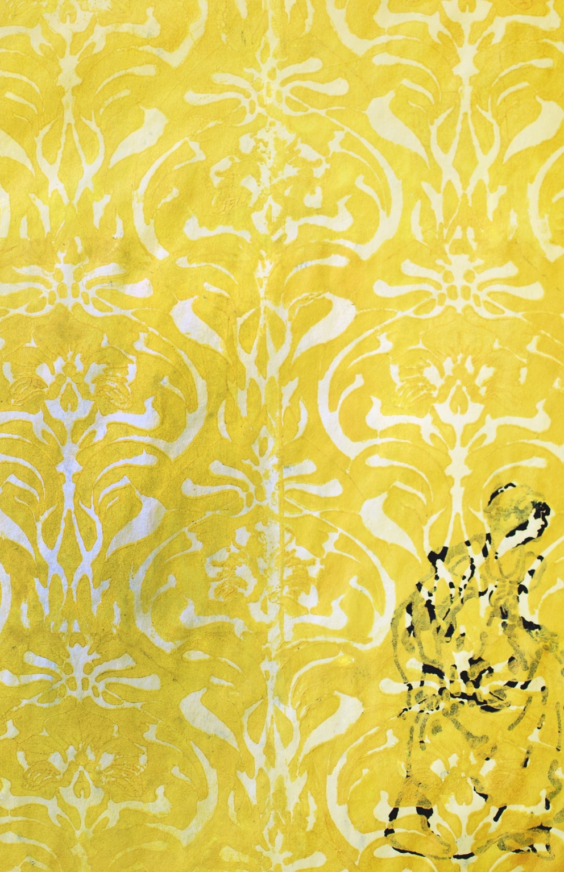
The Wallpaper
It’s definitely not a coincidence that the woman in the wallpaper is trapped behind a pattern. We can conceive of societal norms and mores as types of patterns that metaphorically restrict our movements. The woman who the narrator imagines she sees trapped behind a pattern is simply a more direct embodiment of that metaphorical restriction.
Scholars have made much of the fact that the narrator starts referring to the wallpaper as "the paper." Given that the narrator has a repressed literary bent, it is no great stretch of the imagination to posit that the (wall)paper becomes her text. Her intellect restrained from reading and writing, the narrator’s mind instead turns to her surroundings and settles upon the wallpaper as an intellectual challenge.

Slide 29
Sunlight / Moonlight
The moon has long been associated with female power as with early fertility-centred societies and the Greek goddess Artemis the huntress whose natural realm was the light of the moon. For the Narrator of “The Yellow Wallpaper” the contrast between daytime with its attendant limitations and night-time with its attendant freedoms are symbolised by the alternating effects of sunlight and daylight upon the wallpaper.
During the day, the Narrator’s freedom is checked by her physician/husband’s “rest” treatment. Though she can see a bay in the distance and paths leading to it, she cannot move beyond the confines of the estate. Daytime is also associated with work, an activity overseen if not performed by men in Gilman’s time. As an upper-middle class woman in the Nineteenth century, the prevailing societal codes further restrict the Narrator’s daytime activities to housekeeping.
At night, however, while her husband is either asleep or away, the Narrator’s mind is free to roam the sub-pattern revealed by the moonlight upon the wallpaper. Thus, the moonlight symbolically acts in consort with the Narrator’s imagination to free it from the male-dominated confines of the daytime and, like the woman in the sub-pattern, roam free of interference from those that would seek to hem it in.

Slide 30
Further reading:
You may wish to read more about the moon as a literary symbol. It’s quite fascinating.
https://universavvy.com/different-symbolic-meanings-of-moon

Slide 31
END OF SESSION 3

Slide 32
SESSION 4
Character Analysis

Slide 33
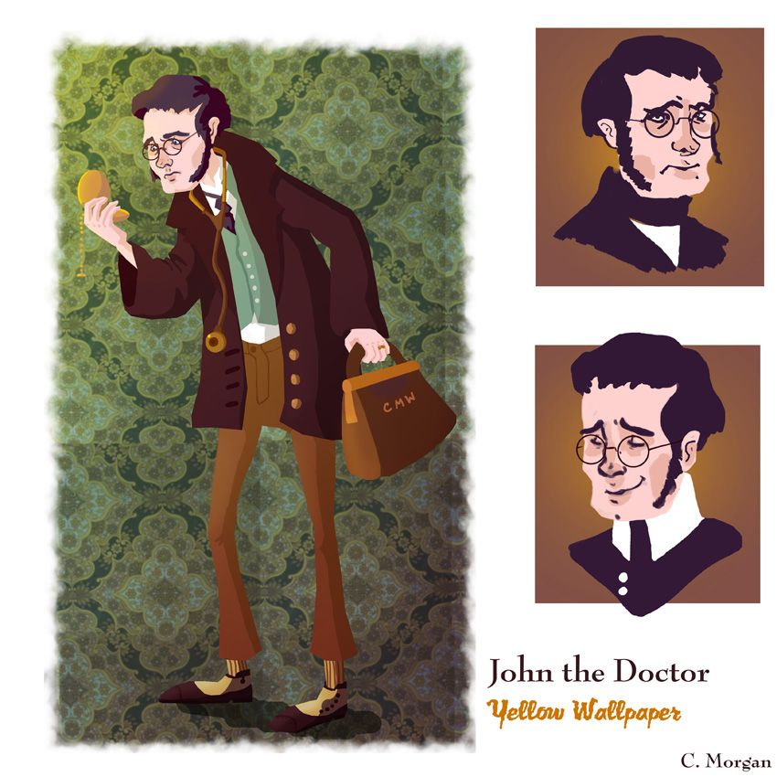
We will focus on how John speaks to the narrator.

Slide 34
‘What is it, little girl?’ he said. ‘Don’t go walking about like that – you’ll get cold.’
I thought it was a good time to talk, so I told him that I really was not gaining here, and that I wished he would take me away.
‘Why darling!’ said he, ‘our lease will be up in three weeks, and I can’t see how to leave before. The repairs are not done at home, and I cannot possibly leave town just now. Of course if you were in any danger, I could and would, but you really are better, dear, whether you can see it or not. I am a doctor, dear, and I know. You are gaining flesh and color, your appetite is better, I feel really much easier about you.’
‘I don’t weigh a bit more,’ said I, ‘nor as much; and my appetite may be better in the evening when you are here, but it is worse in the morning when you are away!’
‘Bless her little heart!’ said he with a big hug, ‘she shall be as sick as she pleases! But now let’s improve the shining hours by going to sleep, and talk about it in the morning!’
‘And you won’t go away?’ I asked gloomily.
‘Why, how can I, dear? It is only three weeks more and then we will take a nice little trip of a few days while Jennie is getting the house ready. Really dear you are better!’
‘Better in body perhaps –’ I began, and stopped short, for he sat up straight and looked at me with such a stern, reproachful look that I could not say another word.
‘My darling,’ said he, ‘I beg of you, for my sake and for our child’s sake, as well as for your own, that you will never for one instant let that idea enter your mind! There is nothing so dangerous, so fascinating, to a temperament like yours. It is a false and foolish fancy. Can you not trust me as a physician when I tell you so?’
Notes:
What is he doing? Look at the coloured sections?

Slide 35
John
What do you think John represents in the story?
How does he treat his wife?
How would you describe their relationship? Are they suited?
How does the narrator describe him at the end?
Extension: Can you link your understanding of John's character to feminist literary theory?
If you want to look at the other side of John, how he’s described by his wife, go here:
https://www.sparknotes.com/lit/yellowwallpaper/quotes/character/john/

Slide 36
John
Main character?
Villain?
Treatment based on Weir Mitchell’s ‘rest cure’ – was he was trying his best based on the science at the time?
All-encompassing authority - husband and doctor.
Patronising = “little goose” and “fancies”.
Dry, clinical rationality = unsuited to understand his imaginative wife.
John knows his wife only superficially. He sees the “outer pattern” but misses the trapped, struggling woman inside.
Treats her as a “case” or a “wife” and not as a person.
End – she doesn’t recognise him either “that man”.
Extension: Can you link your understanding of John's character to feminist literary theory?
If you want to look at the other side of John, how he’s described by his wife, go here:
https://www.sparknotes.com/lit/yellowwallpaper/quotes/character/john/

Slide 37
END OF SESSION 4

Slide 38
SESSION 5
CPG: Why I wrote The Yellow Wallpaper

Slide 39
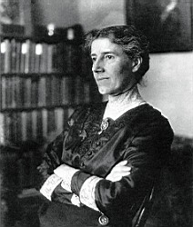
AO3: Context
Demonstrate understanding of the significance and influence of the contexts in which literary texts are written and received
Relate texts to their social, cultural and historical contexts; explain how texts have been influential and significant to self, and other readers in different contexts and at different times
First, based on everything you know…
What do you think CPG’s intentions were with The Yellow Wallpaper?
Why do you think she wrote it?
What did she want to show / expose?

Slide 40
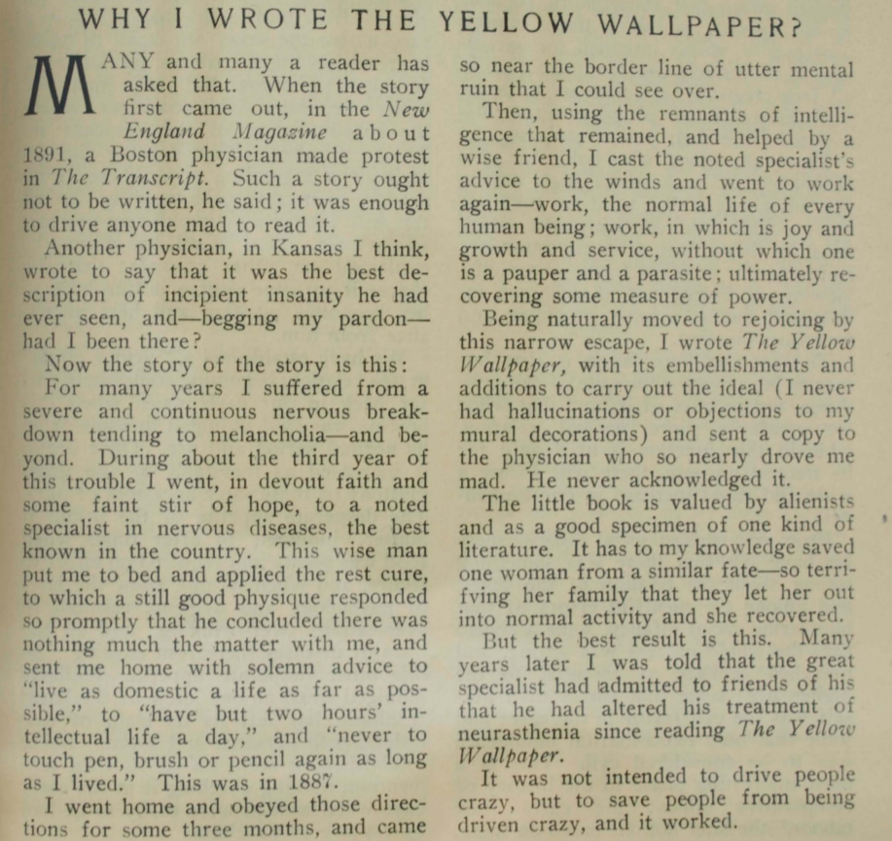
She suffered from a nervous breakdown and went to a doctor for help.
He suggested the rest cure, and told her to live a ‘domestic’ life.
This almost drove her mad, so she ignored him and began to work again.
For A Level study, you should be then asking questions and researching to find the answers to those questions. E.g. What was the ‘rest cure’? Your reading might lead you to ask more questions. This is great. But be sure to make all reference relevant to your essay titles.

Slide 41
Influential American neurologist Silas Weir Mitchell developed the rest cure in the late 1800s for the treatment of hysteria, neurasthenia and other nervous illnesses. It became widely used in the US and UK, but was prescribed more often for women than men. It was frequently used to treat anorexia nervosa. The treatment kept some patients alive and others out of asylums, though some patients and doctors considered the cure worse than the disease.
The rest cure usually lasted six to eight weeks. It involved isolation from friends and family. It also enforced bed rest, and nearly constant feeding on a fatty, milk-based diet. Patients were force-fed if necessary - effectively reduced to the dependency of an infant. Nurses cleaned and fed them, and turned them over in bed. Doctors used massage and electrotherapy to maintain muscle tone. Patients were sometimes prohibited from talking, reading, writing and even sewing.
Mitchell believed the point of the rest cure was physical and moral. It boosted the patient’s weight and increased blood supply. It also removed the patient from a potentially toxic social atmosphere at home. However, the implicit point was the neurologist breaking his (almost always female) patient’s will. Some outspoken and independent women received the rest cure. These included writers Virginia Woolf and Charlotte Perkins Gilman. They reacted fiercely against the treatment and doctors practising it, and wrote about the experience. Later feminist scholars argued the rest cure reinforced an archaic and oppressive notion that women should submit unquestioningly to male authority because it was good for their health.
In order to score high marks for AO3 (context), you’ll need to engage with what you learn and use it to cast light on the text you’re studying.
Notes:
Can you summarise what rest cure was?

Slide 42
END OF SESSION 5

Slide 43
SESSION 6
The Unreliable Narrator?

Slide 44


Slide 45
First person narrative
Advantages | Disadvantages
Get inside the narrator’s mind Personal Can evoke sympathy or empathy Feels more reliable…but… | Narrows the experience Difficult to get a picture of the narrator’s physicality Biased Unreliable
Notes:
Make a list of the advantages and disadvantages of first person narratives. Think about books that you have read before. Do you link first person narratives?

Slide 46
In what ways could our narrator be unreliable?
So why has CPG chosen a first persona narrator if t makes us doubt her?
Notes:
Make some notes on these questions

Slide 47
In what ways could our narrator be unreliable?
Do her perceptions actually reflect what’s going on or is she going mad?
Does she begin to sound paranoid? She might have a reason to be, though!
Has she presented John fairly in her descriptions?
Can we trust her version of the their conversations?

Slide 48
Why has CPG chosen a first persona narrator if it makes us doubt her?
Ironic indirection: If we took her words at face value, we would believe that her husband is kind and loving, that she really is physically ill...and that women really do get trapped in wallpaper.
It creates a sense of immediacy and intimacy.
It sounds like she trusts us and she is colluding with us.
The close relationship with the reader encourages us to sympathise with her.
Important when considering CPG’s intentions.

Slide 49

FURTHER READING (First person narratives)
Notes:
Have you read any of the following first person narratives?

Slide 50
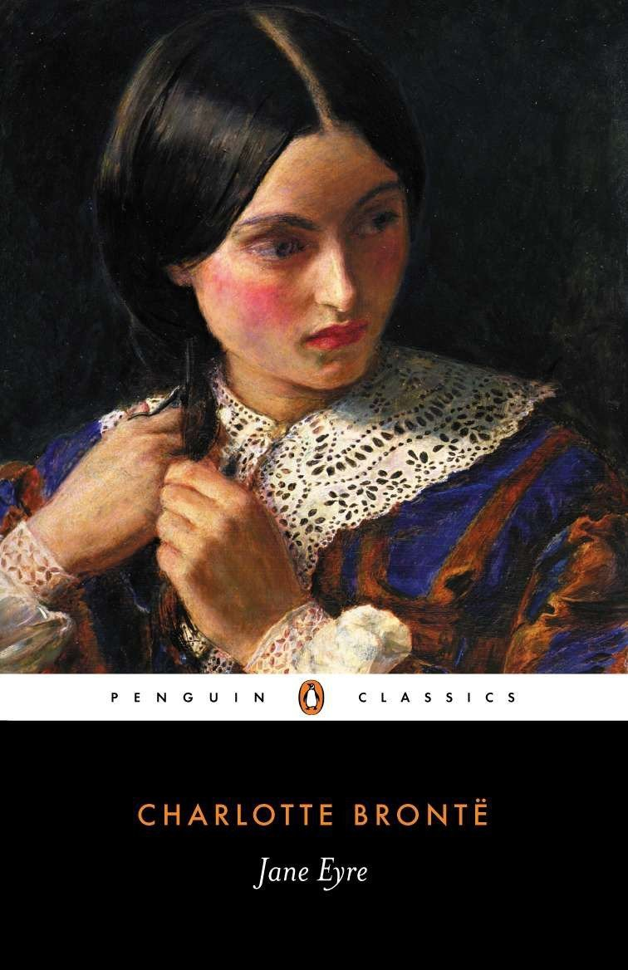
Jane Eyre by Charlotte Brontë
Jane comes from nothing but she desires everything life can offer her. And when she finds work as a governess in a mysterious mansion, it seems she has finally met her match with the darkly fascinating Mr Rochester. But Thornfield Hall contains a shameful secret - one that could keep Jane and Rochester apart forever. Can she choose between what is right, and her one chance of happiness?

Slide 51
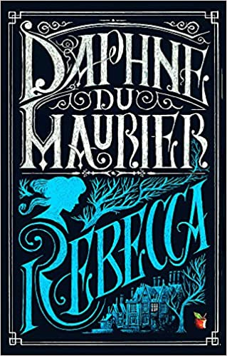
Rebecca by Daphne Du Maurier
Last night I dreamt I went to Manderley again...
With these words a reader is swept up into a world of secrets and lies; one of the most passionate, psychologically twisting and complex stories of all-time.
Working as a lady's companion, the orphaned heroine of Rebecca learns her place. Life begins to look very bleak until, on a trip to the South of France, she meets Maxim de Winter, a handsome widower whose sudden proposal of marriage takes her by surprise. Whisked from glamorous Monte Carlo to his brooding estate, Manderley, on the Cornish Coast, the new Mrs de Winter finds Max a changed man. And the memory of his dead wife Rebecca is forever kept alive by the forbidding Mrs Danvers . . .

Slide 52
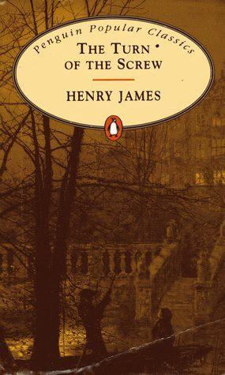
Turn of the Screw by Henry James
James’ eerie novella is a ghost story — or is it? The story is the self-reported manuscript of a governess who comes to take care of two orphans, Miles and Flora, at a country house in Essex. After she arrives at the estate, the governess encounters the ghosts of two former employees who have died. She’s the only person who can see the ghosts, but she’s convinced that they’re real. Is this a ghost story or a portrait of a woman’s mental breakdown? James keeps the reader guessing and the critics picking sides.

Slide 53
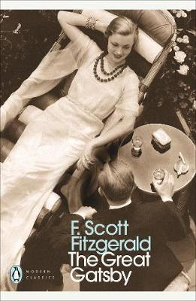
The Great Gatsby by F. Scott Fitzgerald
Only Gatsby, the man who gives his name to this book, was exempt from my reaction – Gatsby who represented everything for which I have unaffected scorn. If personality is an unbroken series of successful gestures, then there was something gorgeous about him, some heightened sensitivity to the promises of life, as if he were related to one of those intricate machines that measure earthquakes ten thousand miles away.
The Great Gatsby is F. Scott Fitzgerald's brilliant fable of the hedonistic excess and tragic reality of 1920s America.
Young, handsome and fabulously rich, Jay Gatsby is the bright star of the Jazz Age, but as writer Nick Carraway is drawn into the decadent orbit of his Long Island mansion, where the party never seems to end, he finds himself faced by the mystery of Gatsby's origins and desires.
Beneath the shimmering surface of his life, Gatsby is hiding a secret: a silent longing that can never be fulfilled. And soon, this destructive obsession will force his world to unravel.

Slide 54
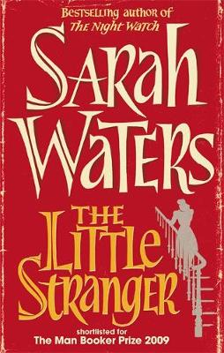
The Little Stranger by Sarah Waters
In a dusty post-war summer in rural Warwickshire, a doctor is called to a patient at lonely Hundreds Hall.
Home to the Ayres family for over two centuries, the Georgian house, once grand and handsome, is now in decline, its masonry crumbling, its gardens choked with weeds, its owners - mother, son and daughter - struggling to keep pace.
But are the Ayreses haunted by something more sinister than a dying way of life? Little does Dr Faraday know how closely, and how terrifyingly, their story is about to become entwined with his.

Slide 55
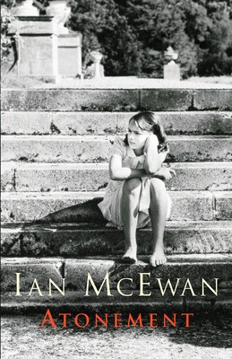
Atonement by Ian McEwan
On the hottest day of the summer of 1935, thirteen-year-old Briony Tallis sees her sister Cecilia strip off her clothes and plunge into the fountain in the garden of their country house. Watching her too is Robbie Turner who, like Cecilia, has recently come down from Cambridge. By the end of that day, the lives of all three will have been changed for ever, as Briony commits a crime for which she will spend the rest of her life trying to atone.

Slide 56
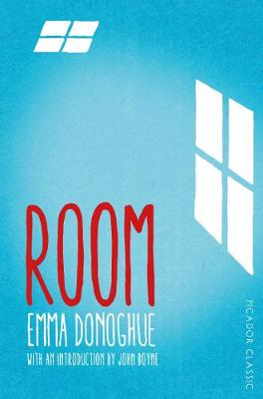
Room by Emma Donaghue
Today I'm five. I was four last night going to sleep in Wardrobe, but when I wake up in Bed in the dark I'm changed to five, abracadabra.
Jack lives with his Ma in Room. Room has a single locked door and a skylight, and it measures ten feet by ten feet. Jack loves watching TV but he knows that nothing he sees on the screen is truly real - only him, Ma and the things in Room. Until the day Ma admits there is a world outside.
Devastating yet uplifting, Room by Emma Donoghue is a luminous portrait of a boundless maternal love.

Slide 57

Life of Pi by Yann Martel
One boy, one boat, one tiger . . . After the tragic sinking of a cargo ship, a solitary lifeboat remains bobbing on the wild, blue Pacific. The only survivors from the wreck are a sixteen-year-old boy named Pi, a hyena, a zebra (with a broken leg), a female orang-utan - and a 450-pound Royal Bengal tiger. The scene is set for one of the most extraordinary and best-loved works of fiction in recent years.

Slide 58
END OF COURSE
Literature Enrichment 1
Well done!

