Slide 1


Why Study Psychology?

Slide 2

Why study Psychology at A level and, potentially, at university beyond that?
“A degree in psychology offers not only a pathway to becoming a psychologist, but also knowledge and skills that you can apply in a wide range of careers.”
- Professor Ann Colley, CPsychol Chief Executive, The British Psychological Society

Slide 3
What can a degree in Psychology offer me?
Many degree courses are accredited and follow the professional body guidelines set out by the British Psychological Society. This is important if you want to pursue a career as a practicing psychologist with chartered status.
Courses can focus on scientific research and/or applied psychology.
Many course providers will therefore offer research facilities for studying perception, developmental psychology, cognition, and behavioural neuroscience, as well as for the applied side, such as studying neurorehabilitation, education, and health.
*UCAS – 2019

Slide 4

Did you know..
Psychology is the 4th most popular degree choice? Psychology is one of the UKs fastest growing subjects.
One in 24 of all graduates in 2018 had psychology degrees.

Slide 5

What are the key reasons why students choose to study Psychology at Degree level?
Interest in conducting research
Fascination about the human mind
A desire to learn more about why we behave in the way that we do

Slide 6
What are the entry requirements?
Having A level's in all three sciences isn't considered to be a necessity for all Universities. Each university will have their own entry requirements for a psychology degree. However, many universities require at least one of your A levels to be a B in a science - either chemistry, physics, biology, or maths.
Other subjects which are preferable at A level include:
sociology, geography, anthropology, economics, politics, philosophy, history and literature.
This is due to the nature of the courses and the skill of essay writing, rather that the content covered.

Slide 7
Are all degree courses for Psychology the same?
No!
Colleges/Universities will offer specialist modules which may be compulsory or you may be able to choose some routes of study.
Often having the ability to choose which modules you wish to study is introduced in Year 2. You can then choose what to focus your dissertation on in your 3rd year.

Slide 8
Applied psychology
Social psychology
Child psychology
Some specific Psychology Modules at UK Universities
Forensic psychology
Clinical psychology
Educational psychology
Developmental psychology
*Correct as of July 2018

Slide 9

These are just a few of the modules offered by Universities.
It is important that you check which modules are being offered at universities before you apply to study there.
Make sure the university offers modules which spark interest and may be linked to your future career aspirations.

Slide 10

Key statistics
Over 75,000 students studied Psychology at university in 2014/15:
92% UK
8% international
73% full-time
27% part-time
- UCAS statistics

Slide 11
Course options
Single, joint, and multiple subject combinations are offered at different universities
The most common qualification is a Bachelors degree in science (BSc (Hons)). Alternatively, your degree may be BA (Hons).
Foundation Certificates and Master’s degrees are also qualifications in psychology.
Courses on offer may be full-time or part-time; they may offer distance learning and some may have offer a placement (sandwich courses)
Degree courses in Psychology are for 3 or 4 years (dependent on whether the course offers a placement year)

Slide 12
Subject combinations
Psychology is offered in combination with a very wide range of subjects, including:
Criminology, criminal investigation, forensic science
Sociology, social anthropology, social care, philosophy
Biology, zoology, animal behaviour, environmental science
Education, childhood studies, child development, counselling
Accounting, finance, HR management, advertising, business, economics, entrepreneurship, marketing
Archaeology, architectural design, art and design history, Celtic studies
Computer science, computing, digital media and information, film and media studies
English, creative writing, journalism, publishing, drama and theatre studies, dance, music
Philosophy, politics, law, international relations
Social history, European studies, tourism, geography, religious studies
Mathematics, sport/sports studies

Slide 13
Why study Psychology?
Have you ever wondered whether criminals are born or made?
Have you ever wondered why siblings can behave so differently?
Have you ever wondered why some people suffer from mental health problems and not others?
These are some of the questions that you will analyse during the A level course. The study of Psychology allows students to critically consider a range of explanations to such questions through key theories and concepts.

Slide 14
Competition for places on degree courses
As Psychology is one of the most popular degree choices, competition for places on psychology courses is strong.
Due to this competition, the entry requirements are quite demanding. Admissions tutors often request high grades or UCAS Tariff points.
In addition to A level grades, many universities also take GCSE grades into consideration and carefully read personal statements and work experience as a way to choose the most desirable students for the course.

Slide 15

TASK:
List down as many jobs as you can that Psychology could support

Slide 16
What careers could a degree in psychology lead you to?
Clinical psychologist
Counselling psychologist
Educational psychologist
Forensic psychologist
Further education teacher
Health psychologist
High intensity therapist
Occupational psychologist
Primary care graduate mental health worker
Psychological wellbeing practitioner
Sport and exercise psychologist
Advice worker
Careers adviser
Counsellor
Detective
Human resources officer
Market researcher
Play therapist
Psychotherapist
Mental health nurse

Slide 17


Success after university
72% of graduates went directly into employment.
The most common career options for graduates in psychology were:
Human health and social work
Education
Retail/administrative and support
Legal, social, and welfare professions
Business, HR, and finance
Marketing, PR, and sales

Slide 18
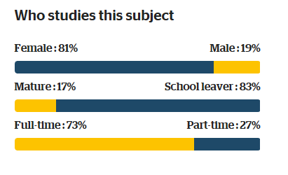
Who studies Psychology at University?
A high proportion of Psychology students are female.
The average amount of teaching hours per week is 10 hours. This includes time in both seminars and lectures.
*statistics taken from ‘Whichuniversity’

Slide 19
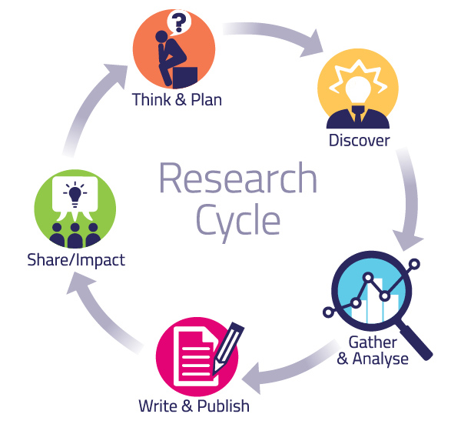
What will I be doing?
You will learn how to conduct psychological research. This provides you with the opportunity to grasp what is involved in different research methods and allow you to determine the strengths and weaknesses of each technique.

Slide 20
What will I be doing?
You will learn key pieces of research in Psychology, and analyse how theories and concepts have changed and developed over time.
You will also learn about how psychology is used in the real word through the study of applied psychology.

Slide 21


How can I prepare?
Develop your psychological knowledge by accessing the following websites:
British Psychological Society
Association of Educational Psychologists
Experimental Psychology Society
British Association for Counselling & Psychotherapy
UK Council for Psychotherapy
Listen to podcasts
Keep up to date with developing literature in psychology.
Read books which have psychological themes.
Watch documentaries relevant to Psychology
Watch the news

Slide 22

Commissioned by The PiXL Club Ltd. May 2019
This resource is strictly for the use of member schools for as long as they remain members of The PiXL Club. It may not be copied, sold, or transferred to a third party or used by the school after membership ceases. Until such time it may be freely used within the member school.
All opinions and contributions are those of the authors. The contents of this resource are not connected with, or endorsed by, any other company, organisation or institution. These papers were made by teachers in good faith based upon our understanding to date.
PiXL Club Ltd endeavour to trace and contact copyright owners. If there are any inadvertent omissions or errors in the acknowledgements or usage, this is unintended and PiXL will remedy these on written notification.

